Slide 1
Compassion A
Final Presentation
May 10th, 2023
CTL: Mohan Hathi
Associate: Ozzy Mendoza
Analysts: Dries Rooryck, Eileen Ye, Joseph Oronto-Pratt, Lauren Teichholtz, Shea Britt

Slide 2
Project Overview
Background:
Compassion supports specific partner churches or communities through Complementary Interventions (CIVs).
Want to do categorization and outcomes analysis to quantify the impact of CIVs; which ones have the greatest impact, which ones need to be redesigned
Tasks:
Unsupervised categorization of CIV data (NLP)
Secondary outcomes correlation to correlate CIVs with results (statistics, visualizations)
Central Question:
What twenty categories can encapsulate the CIV descriptions? Is there a statistically significant difference between L2 results in FCPs where CIVs were implemented and where CIVs were not implemented?
Notes:
Mohan

Slide 3
Datasets
CIV Data
Need Category
L2 Data
Contains information about Compassion community interventions
Contains “need categories” and their corresponding definitions
Contains results of a Survey of Child & Youth Development
Category, Sub-category, Sub-sub-category
Project Description
Cost Per Beneficiary
# of Beneficiaries
Start Date
Location ID
Need Category
Aspirations
Employment
Literacy
Vision
WASH
Description
Need Category
Age Group
0-6
6-8
9-11
12-14
15-18
19+
Score/Rank
Location ID
Notes:
Ozzy

Slide 4
Fall 2022 Case
Surgical Intervention
Immunization
Sanitation - Wastewater
Sanitation - Pollution
Feminine Hygiene
Disease Prevention
Clean Water
Dental
Abuse Prevention
Other Health
Psychotherapy
Scholarships
Educational Infrastructure
IT Infrastructure
Vocational Training
Sex Ed
Sports
Music
General education
Renewable Energy
Housing
Borehole Drilling
Food security
Additional income generation
Livestock rearing
Crops
COVID-19 relief
Drought
Flood
Earthquake
TF-IDF Analysis
Approach that uses frequency of words within project descriptions to determine categories
Background information often has little to do with project
Some important data is blacked out for privacy reasons
Did not produce helpful categories
Unsupervised Learning
Approach that encodes project descriptions into vectors using BERT and then uses HDBSCAN to cluster embeddings
Difficult with dimensionality reduction prior to clustering
Hyperparameters were highly sensitive, so difficulty tuning
Did not produce helpful categories
Lbl2Vec Analysis
Automatically generates jointly embedded label, document, and word vectors and learns topics from predefined keywords
Relies on “similarity scores” which are lower for longer project descriptions (for all categories)
Close similarity scores for most categories
Notes:
Ozzy
It automatically generates jointly embedded label, document and word vectors and returns documents of topics modeled by manually predefined keywords.
Surgical Intervention
Immunization
Sanitation - Wastewater
Sanitation - Pollution
Feminine Hygiene
Disease Prevention
Clean Water
Dental
Abuse Prevention
Other Health
Psychotherapy
Scholarships
Educational Infrastructure
IT Infrastructure
Vocational Training
Sex Ed
Sports
Music
General education
Renewable Energy
Housing
Borehole Drilling
Food security
Additional income generation
Livestock rearing
Crops
COVID-19 relief
Drought
Flood
Earthquake

Slide 5
Unsupervised Classification
Notes:
Mohan

Slide 6
Approaches
Explored a variety of approaches to generate 20 category clusters from ‘descriptions’ data
Consulted online resources and statistics professors/graduate students
Problem is difficult due to unsupervised nature
K-means Clustering with Text Embeddings
K-means clustering groups similar text descriptions into 20 clusters by minimizing the within-cluster sum of squares
Latent Dirichlet Allocation (LDA)
LDA discovers hidden topics within text descriptions by modeling documents as mixtures of topics and topics as mixtures of words
Hierarchical Clustering
Hierarchical clustering builds a tree-like structure (dendrogram) to represent the nested grouping of text descriptions based on their pairwise similarities.
Categories from last semester
Compassion provided categories
Notes:
Mohan

Slide 7

K-means Clustering with Text Embeddings - Overview
Used scikit-learn KMeans class with Word2Vec to produce word embeddings.
Minimizing the within-cluster sum of squares of the vectors
Optimized for number of clusters (between 5 and 50) and vector dimension.
– Limited by K-means being a less optimized algorithm than LDA for topic-modelling.
Basic Premise (credit A. Jeffares)
Notes:
Dries and Lauren

Slide 8
Hierarchical Clustering - Overview
Hierarchical clustering is an unsupervised machine learning technique that organizes data into nested clusters by either continually merging similar groups (agglomerative approach - implemented) or dividing larger clusters (divisive approach)
Forms a tree-like structure known as a dendrogram where the final clusters, which can vary in size, are derived by cutting the dendrogram at a certain level and are entirely data-driven, relying on a defined similarity measure between objects.
Convert text descriptions into embeddings using pre-trained NLP models like transformers (for BERT) or gensim (for Word2Vec), compute pairwise distance metrics, apply agglomerative hierarchical clustering using scipy's linkage function, create a dendrogram to assist with finding where to cut the tree to form clusters, form 20 clusters, and classify text descriptions based on their assigned clusters.
Our implementation with Word2Vec yielded an average coherence score of 0.60 across the 20 formed clusters
Notes:
Joseph and Shea

Slide 9
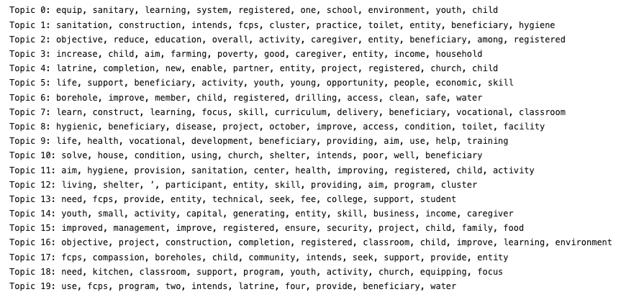
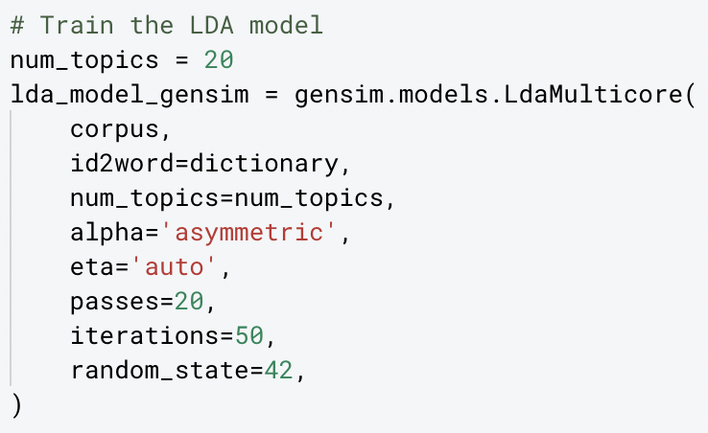
Latent Dirichlet Allocation (LDA) - Overview
LDA discovers hidden topics within text descriptions by modeling documents as mixtures of topics and topics as mixtures of words.
We created this model using gensim to classify the CIV’s into categories
Notable parameters: number of topics, alpha, beta
Coherence score: 0.4359421685
LDA model outputs groups of similar words which we turn into topics
Notes:
Eileen

Slide 10
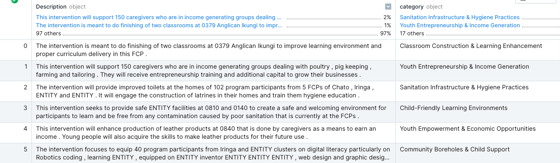
Final Results
Categories were coherent, although one category sometimes represented multiple different ideas
Could be improved if we better understood what types of categories Compassion wants and what they will be used for
Had particular success with LDA and Hierarchical clustering models after tweaking parameters
Descriptions fit nicely into their assigned categories
Notes:
Mohan

Slide 11
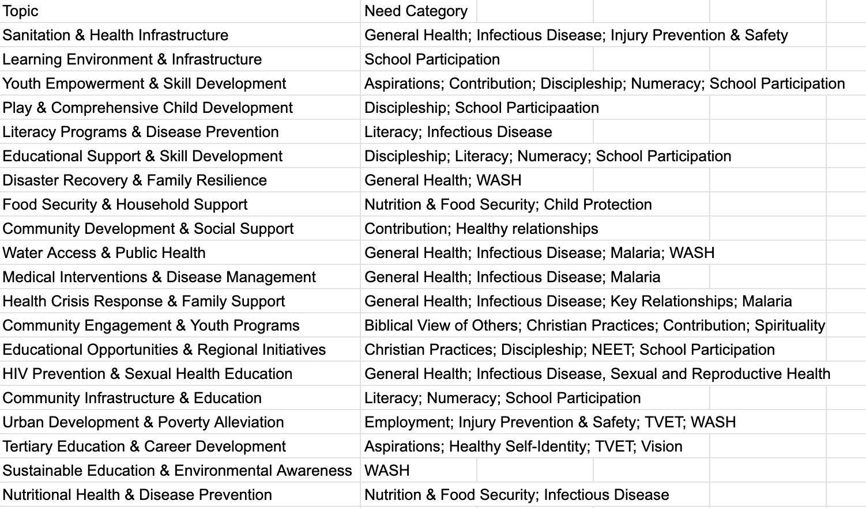
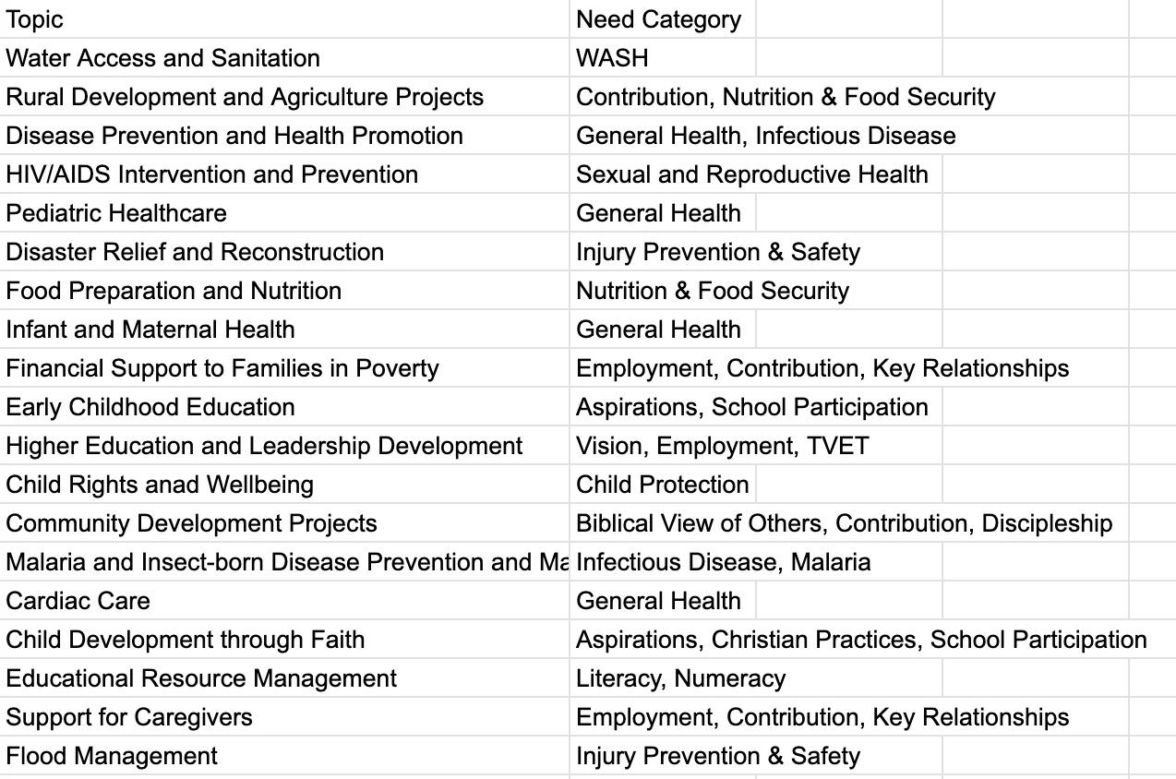
Final Results + Mapping to Need Categories
Compassion asked us to map our topics to the given 20 need categories for both different approaches. We ended up selecting hierarchical categories as the final approach because the mapping closer to 1:1
LDA Hierarchical
Notes:
Ozzy

Slide 12
Outcomes Correlation
Notes:
Mohan

Slide 13
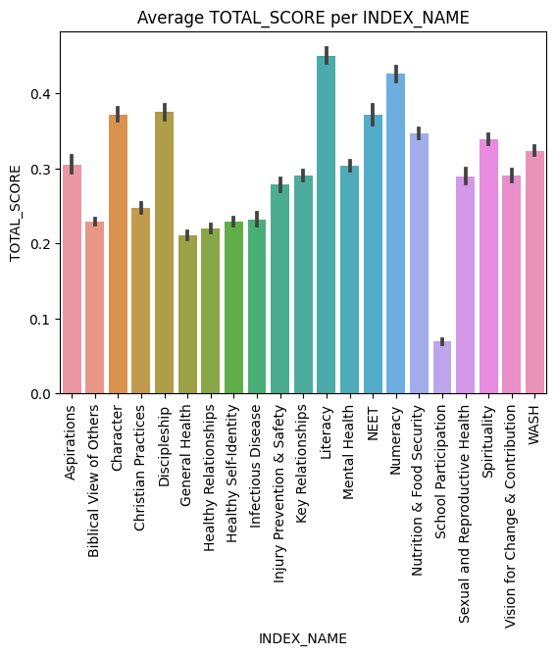
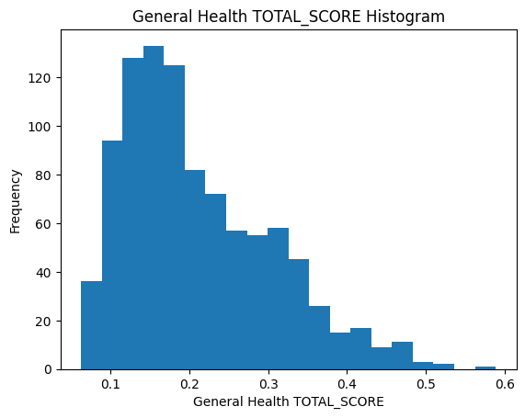
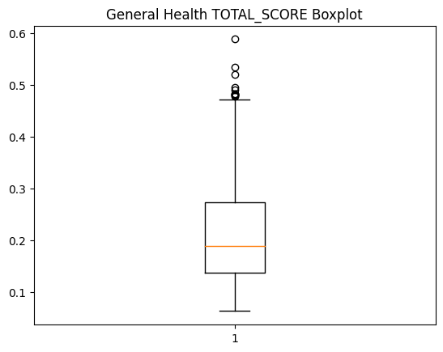
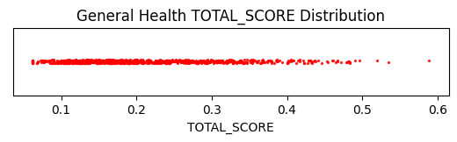
Initial Exploration
“Result” measures the success of a “need category” at a certain location (FCP)
Results can only be compared within need categories
Tried to understand results values as a whole using visualizations
Next mapped CIVs onto the graphs to understand the results distributions when the CIV was implemented vs. not implemented
Notes:
Mohan

Slide 14
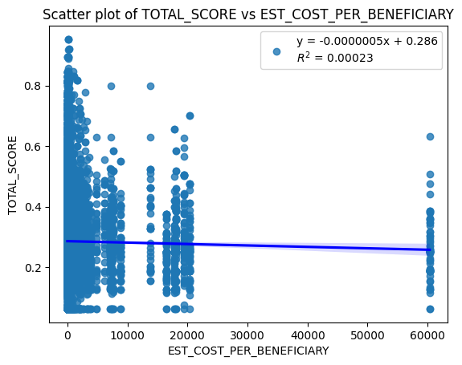
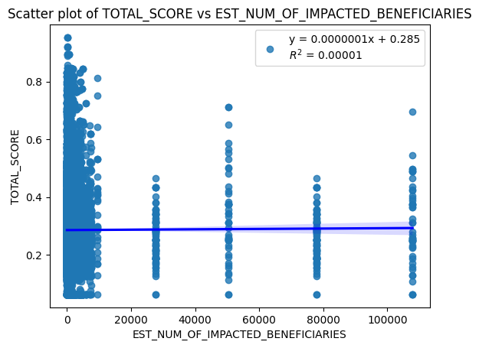
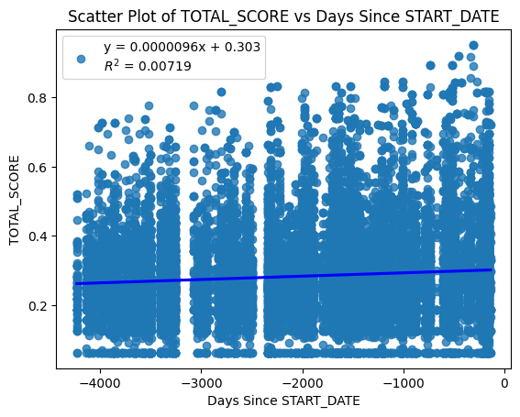
More Exploration
How are the CIV features like “EST_COST_PER_BENEFICIARY”, “EST_NUM_OF_IMPACTED_BENEFICIARIES”, and “Days Since START_DATE” correlated with “TOTAL_SCORE” in the results dataset?
Not very correlated, tells us that a weighted metric (described later) might not be useful
Notes:
Mohan

Slide 15
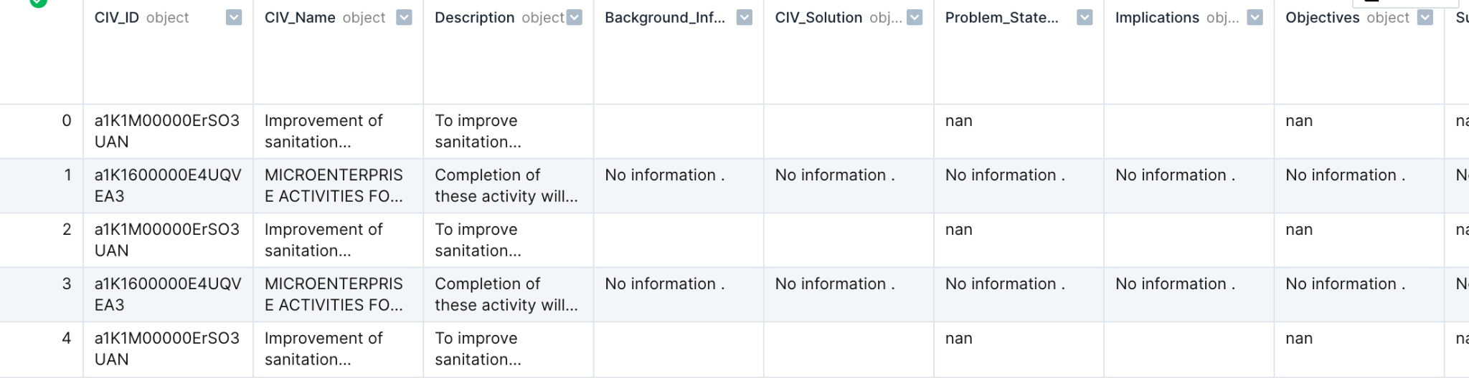
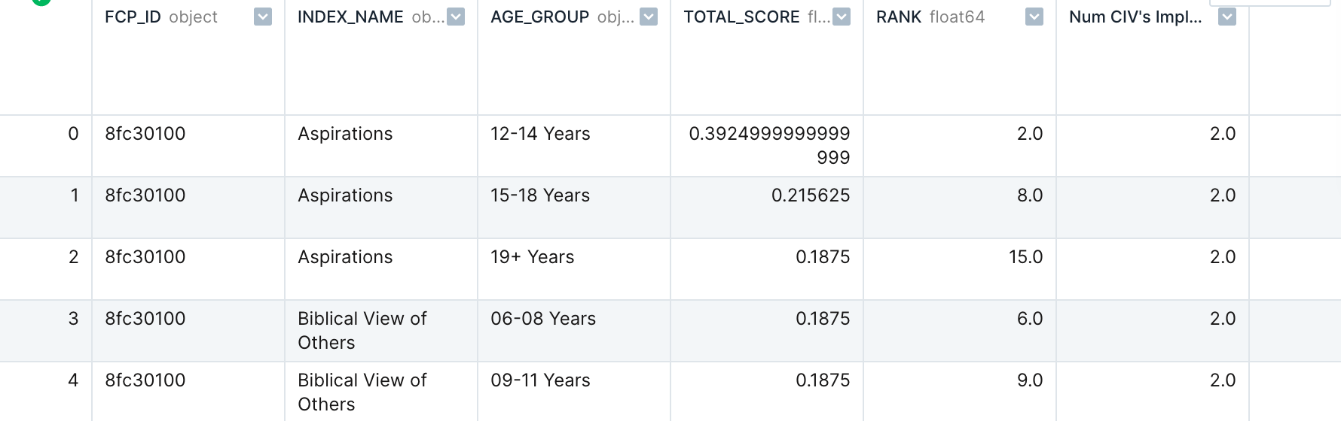
Merging Datasets
Given CIV dataset and L2 outcomes dataset. Need to merge them together on FCP_ID (location) to understand which results had CIVs implemented and which didn’t
Complicated because multiple results are associated with a single FCP_ID, and multiple CIV’s can be implemented at a single FCP_ID. Creates a lot of repeated data.
Approach 1: join datasets by creating a new row for every combination of CIV and results value at an FCP
Approach 2: count the number of CIVs implemented at each results value and create a new column “Num CIV's Implemented”
Notes:
Mohan

Slide 16
Approaches
Used a variety of approaches – statistics, visualizations, models – to understand the relationship between CIV and L2 data. Central question: how do CIVs impact L2 results?
Box and whisker plots to visualize distributions of results with and without interventions for the 20 need categories
Overlaid bar charts to represent the difference between the CIV implemented and CIV not implemented results
Proportion metric to quantify the percentage of CIVs implemented vs. not implemented in all four quartiles of the results data
Mean score comparison between implemented and not implemented results
Permutation importance on the CIV implemented and not implemented results to see if differences in distribution are statistically significant
XGBoost model to predict “result” value for an individual CIV based on the the CIV and FCP information
Analyzed impact of CIV on results scores stratified by need category as well as need category and age group
Notes:
Mohan

Slide 17
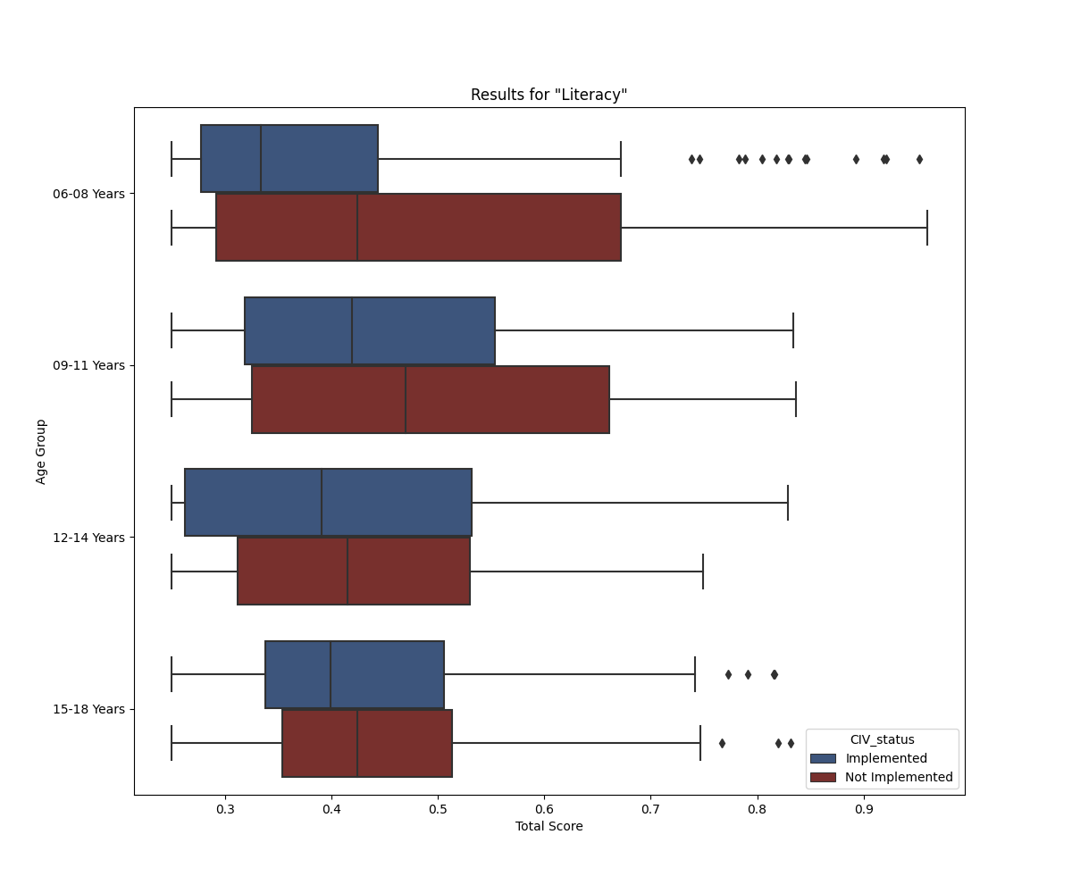
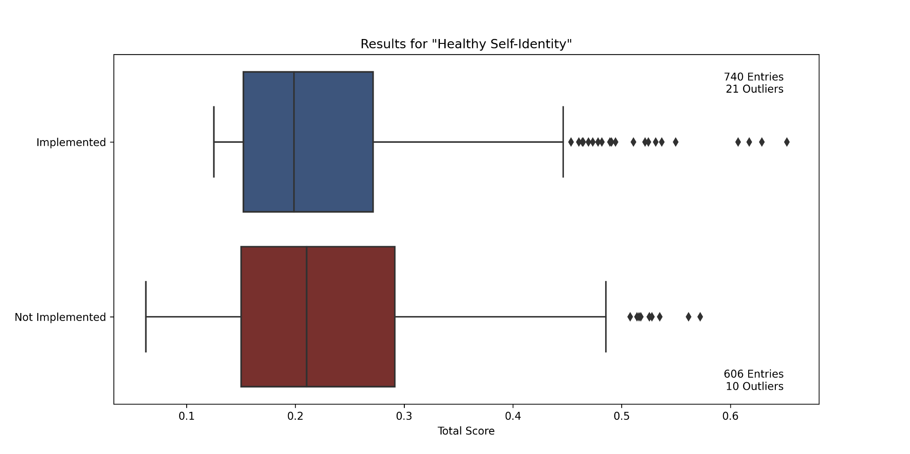
Box and Whisker Plots - Overview
Created box and whisker plots using Seaborn
Merged with the CIV database to differentiate between CIV implemented and not-implemented.
Easy-to-consult visual of the total result for every entry
Stratified by age-group (105 plots)
Aggregated by need category (21 plots)
Example:
Notes:
Dries

Slide 18
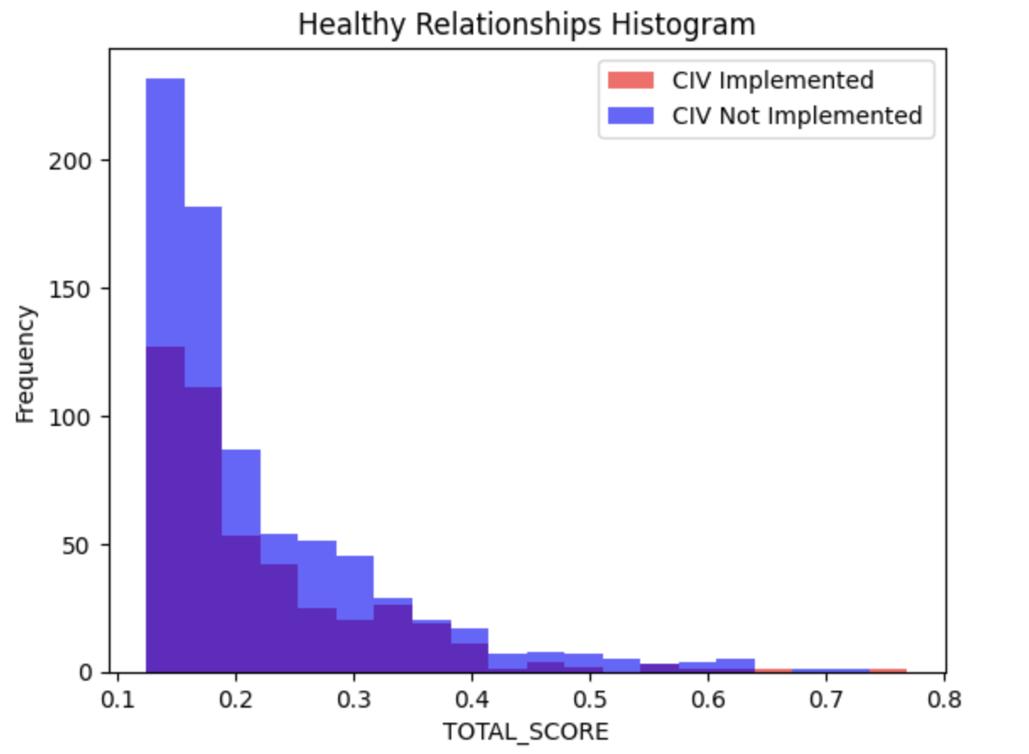
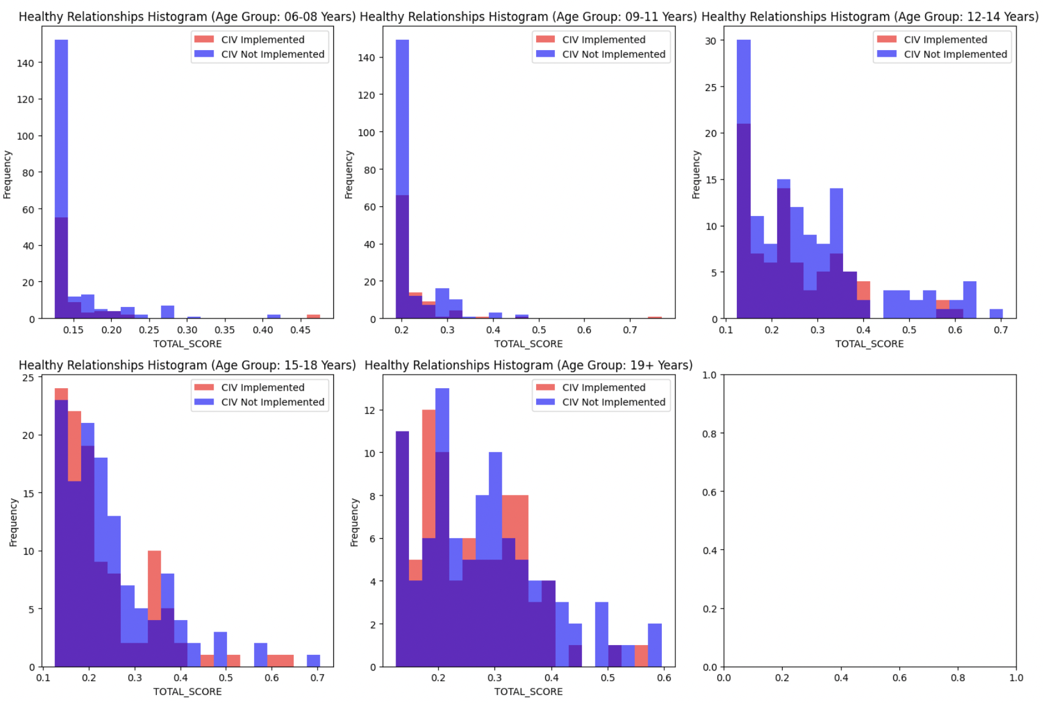
Overlaid Histograms - Overview
Created using matplotlib visualization functions on the merged2 dataframe joining CIV and L2
Includes red-blue legend for differentiating between CIV-implemented and CIV not implemented (overlaid)
Made for each need category with available data
In like manner to the box and whisker plots, created stratified variants (by age group) and non-stratified variants
Example visualization (on the “Healthy Relationships” category):
Notes:
Joseph

Slide 19
Proportion Metric and Mean Result Comparison - Overview
Comparison of conditional means
How does the mean result score compare for results with CIVs implemented and those with CIVs not implemented?
Mean of result score conditional on CIV implementation
What % of result scores in each quartile had CIVs implemented?
Mean of CIV indicator conditional on results in each quartile
Sample Mean Table: General Health
Mean Implemented | Mean Not Implemented | Proportion Implemented in Q1 | Proportion Implemented in Q2 | Proportion Implemented in Q3 | Proportion Implemented in Q4
0.204 | 0.221 | 0.657 | 0.591 | 0.570 | 0.523
Notes:
Lauren

Slide 20
Permutation Importance - Overview
Metric to measure the likelihood that CIVs in the dataset were implemented randomly.
Treated the difference in the means of the total score of initiatives with CIV’s implemented and those without as a test statistic
Program Functionality:
Resamples from dataset, finding all possible permutations, randomly assigning each data point as if CIVs were implemented or not
Collects the test statistic for each resampled dataset and compares it to the original calculating what percentage of datasets had observed values greater than the original.
Mechanism to check if we could conclude that CIVs were not distributed randomly
Our cutoff for the p-value was 0.1 in accordance with Mr. Muller’s guidelines
Notes:
Shea

Slide 21
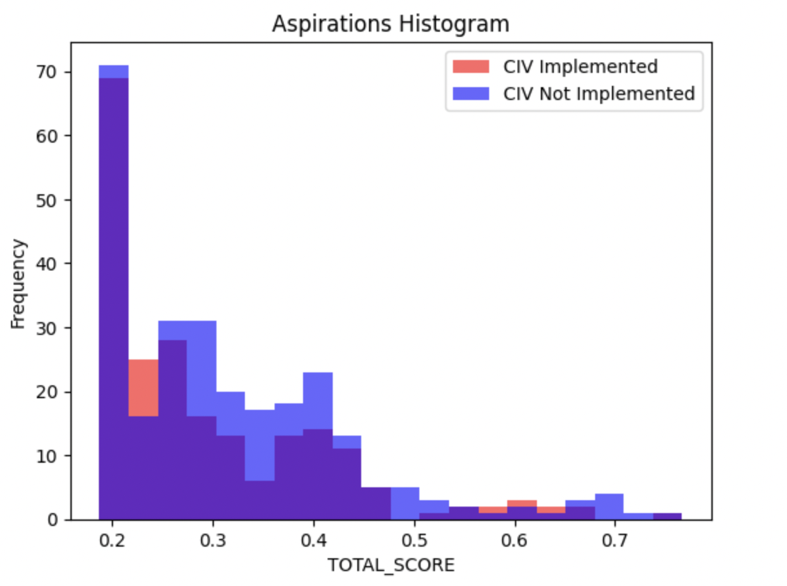
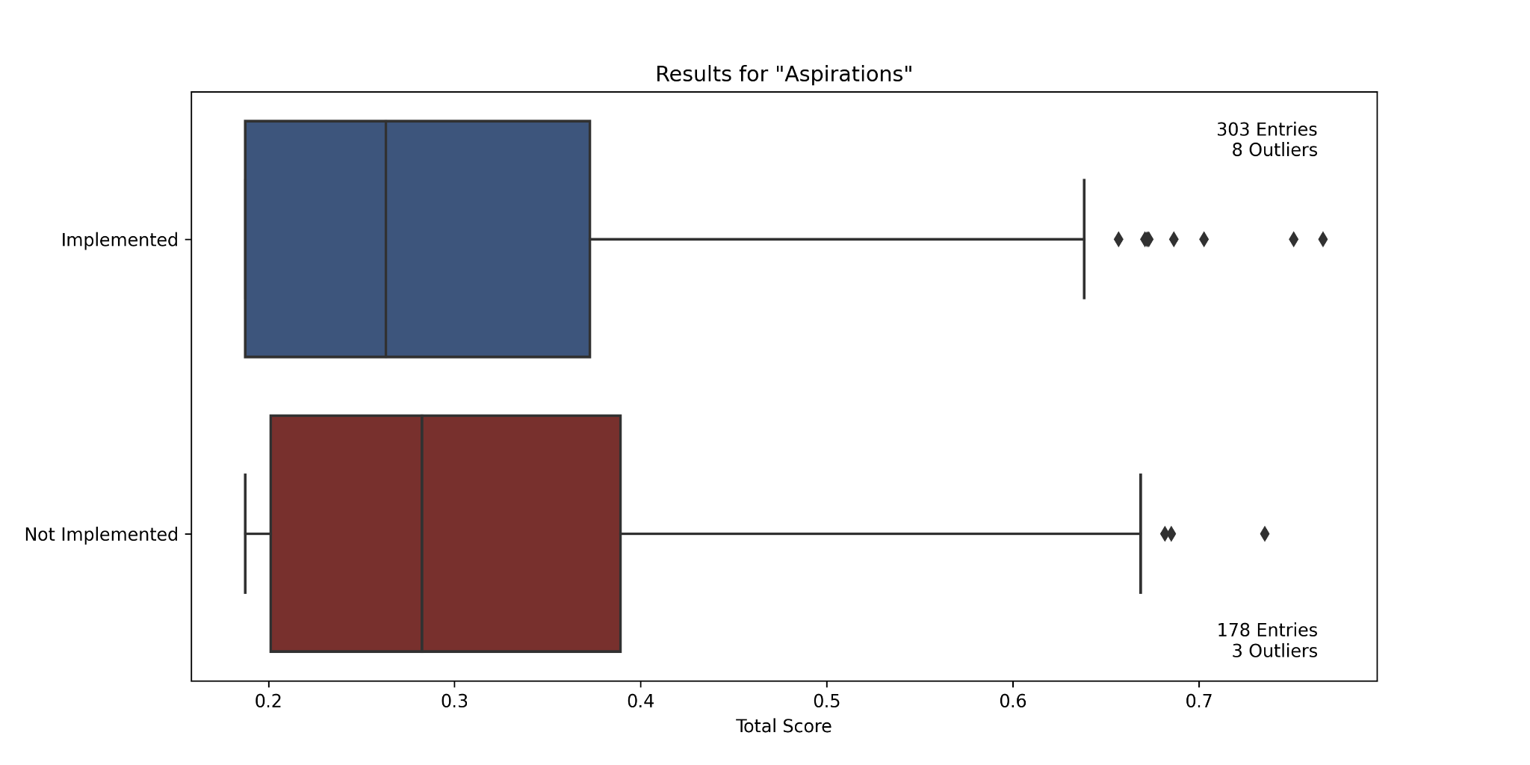
Aspirations
[Related Visualizations]
Permutation Importance
P-value: 0.0635
Reject H_{o}
Mean Implemented | Mean Not Implemented | Proportion Implemented in Q1 | Proportion Implemented in Q2 | Proportion Implemented in Q3 | Proportion Implemented in Q4
0.302 | 0.311 | N/A | 0.675 | 0.567 | 0.603
Notes:
All

Slide 22
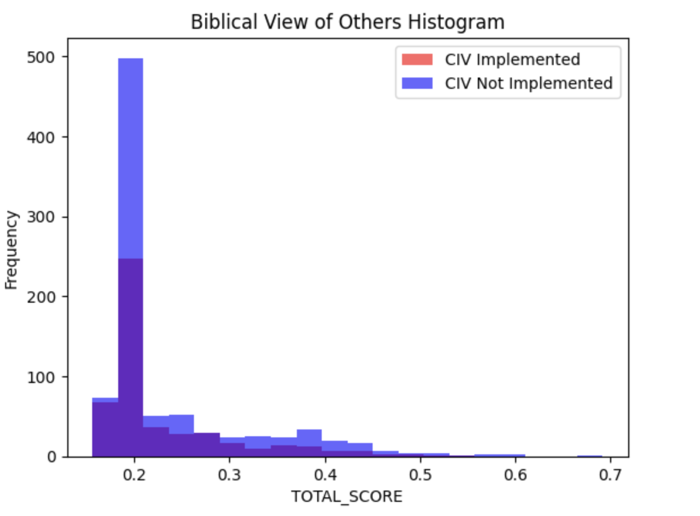
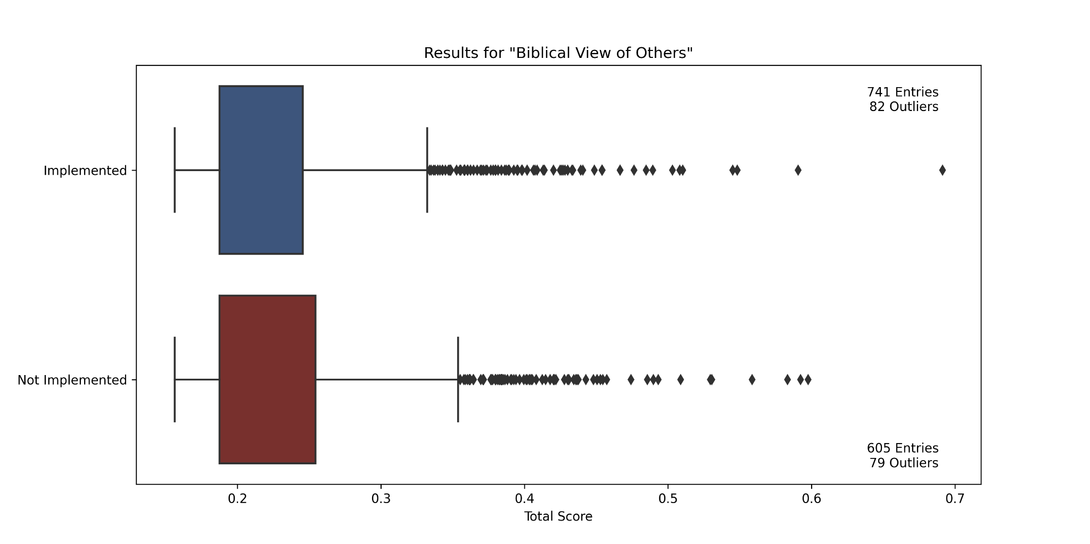
Biblical View of Others
[Related Visualizations]
Permutation Importance
P-value: 0.0643
Reject H_{o}
Mean Implemented | Mean Not Implemented | Proportion Implemented in Q1 | Proportion Implemented in Q2 | Proportion Implemented in Q3 | Proportion Implemented in Q4
0.225 | 0.233 | 0.606 | N/A | 0.545 | 0.537
Notes:
All

Slide 23
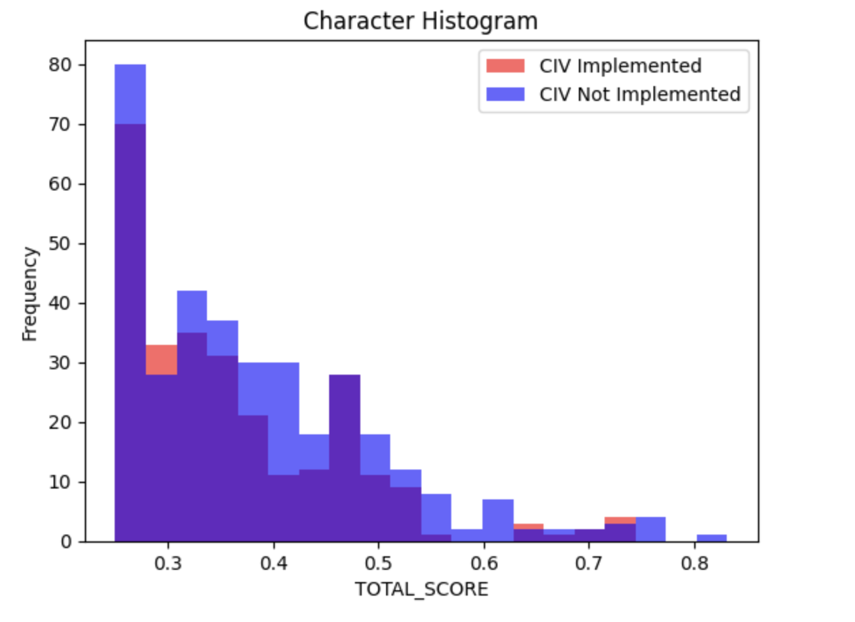
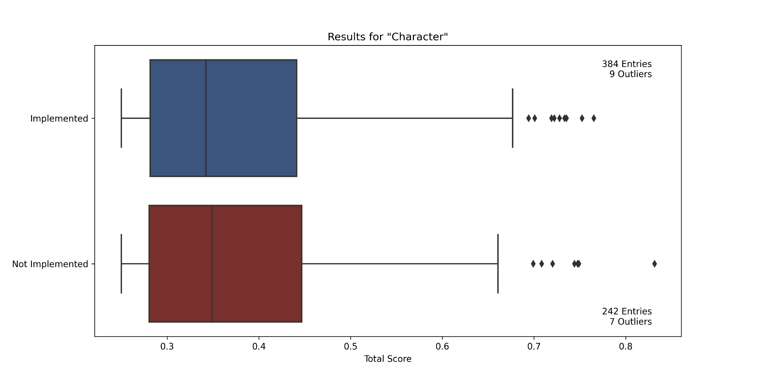
Character
Could also be something with my code, will check, or a slight difference in the category name - Joseph
As far as I can see, There is no data on CP. - Dries
Permutation Importance
P-value: 0.0296
Reject H_{o}
Mean Implemented | Mean Not Implemented | Proportion Implemented in Q1 | Proportion Implemented in Q2 | Proportion Implemented in Q3 | Proportion Implemented in Q4
0.370 | 0.376 | 0.605 | 0.654 | 0.590 | 0.605
Notes:
All

Slide 24
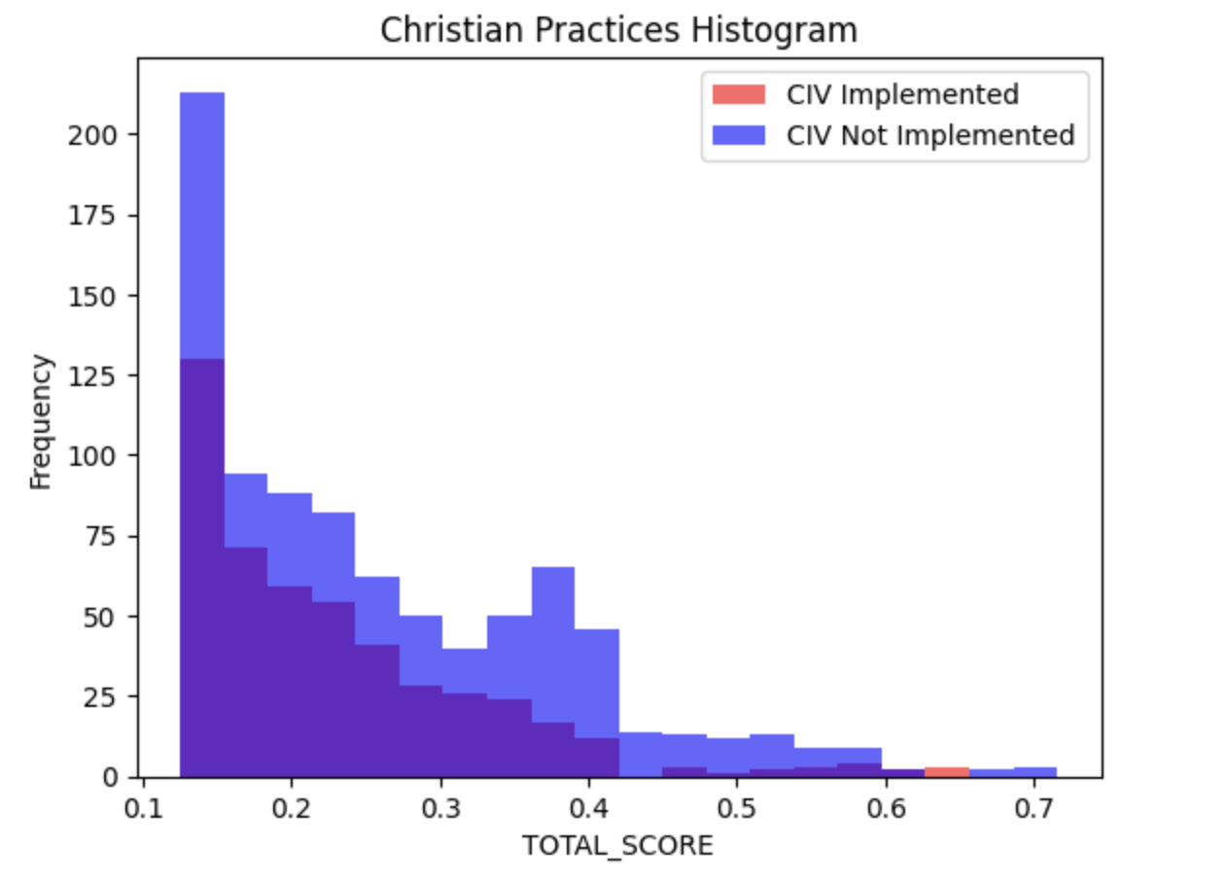
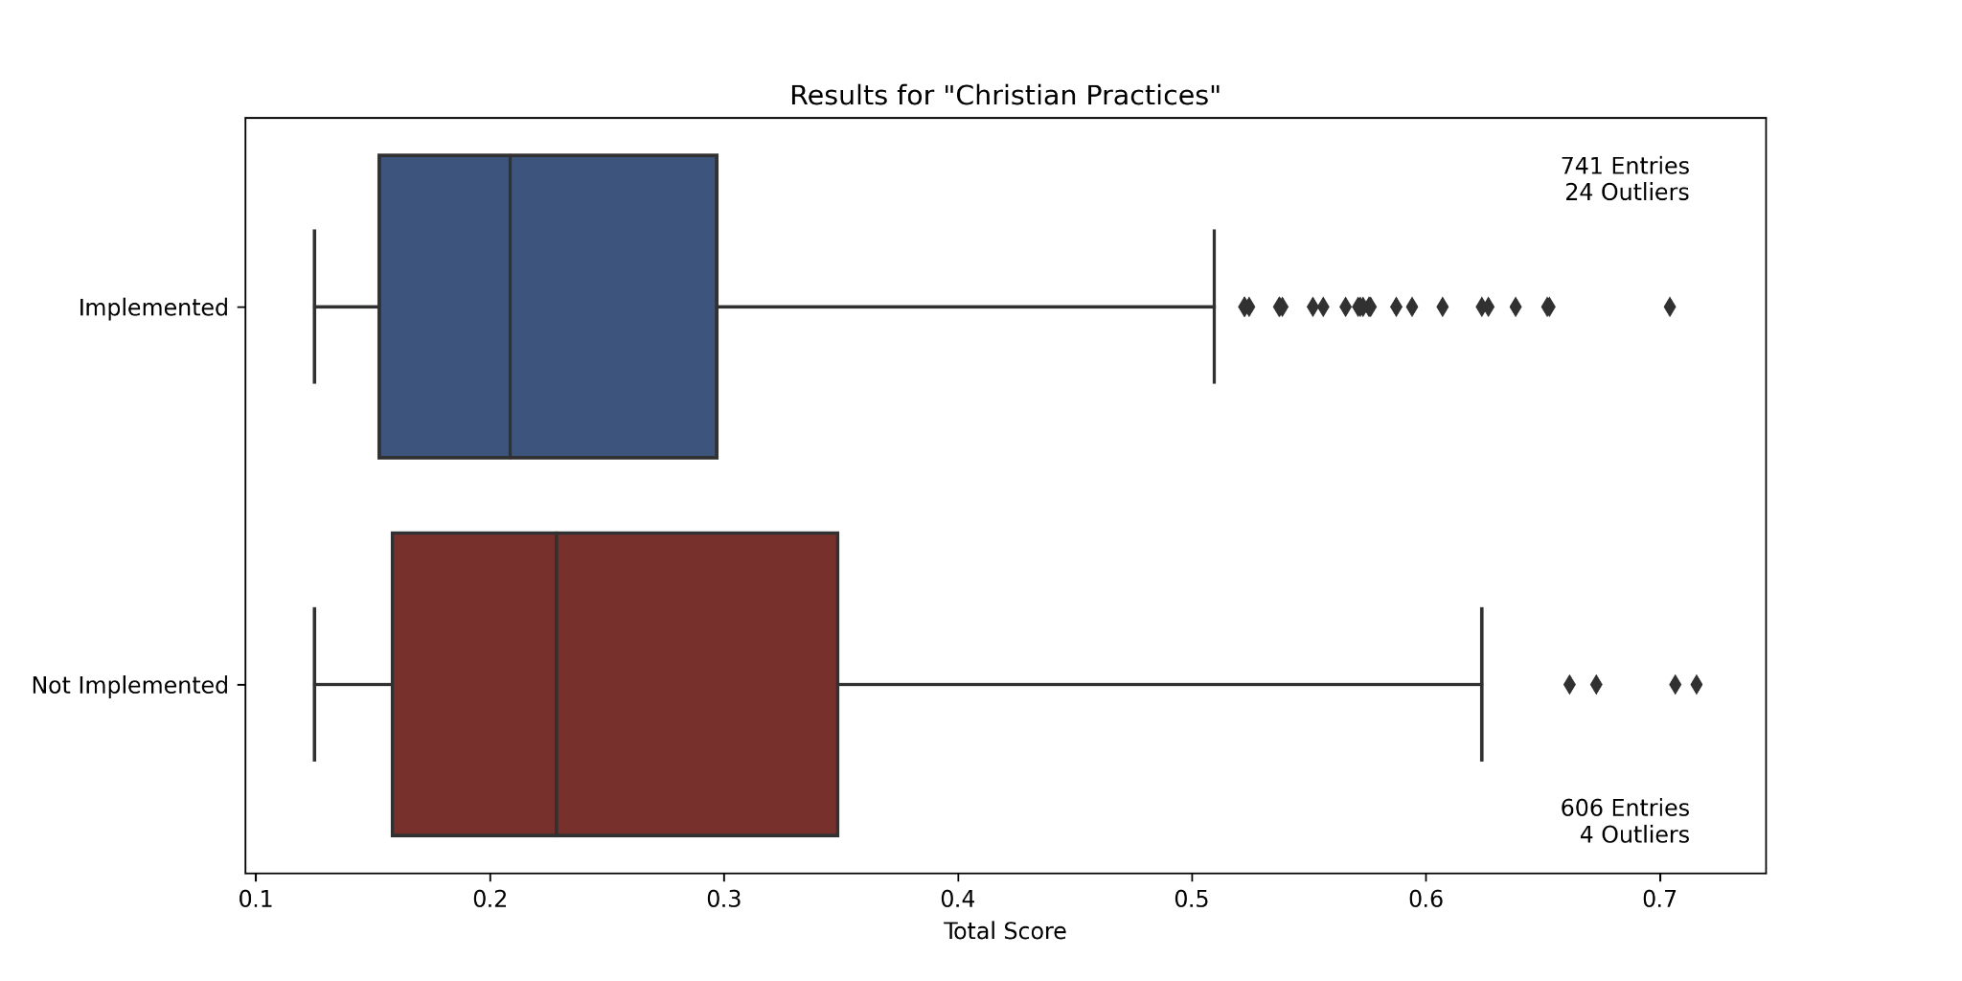
Christian Practices
[Related Visualizations]
Permutation Importance
p-value: 0.00
Reject H_{o}
Mean Implemented | Mean Not Implemented | Proportion Implemented in Q1 | Proportion Implemented in Q2 | Proportion Implemented in Q3 | Proportion Implemented in Q4
0.237 | 0.260 | 0.573 | 0.583 | 0.582 | 0.463
Notes:
All

Slide 25
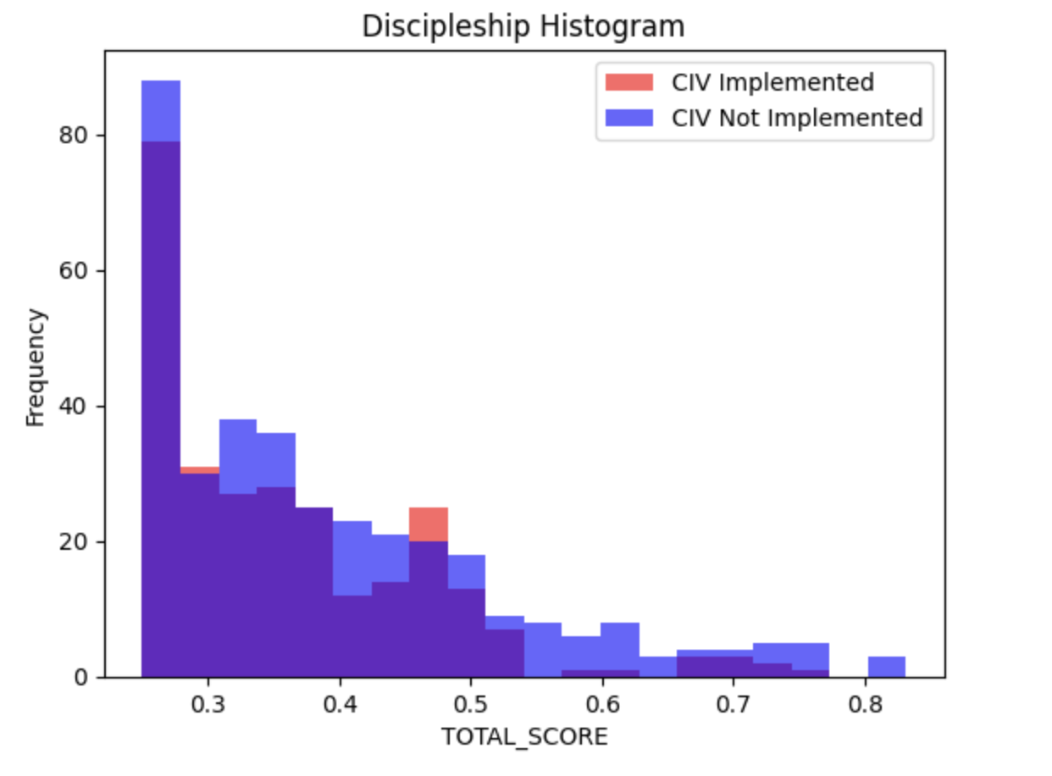
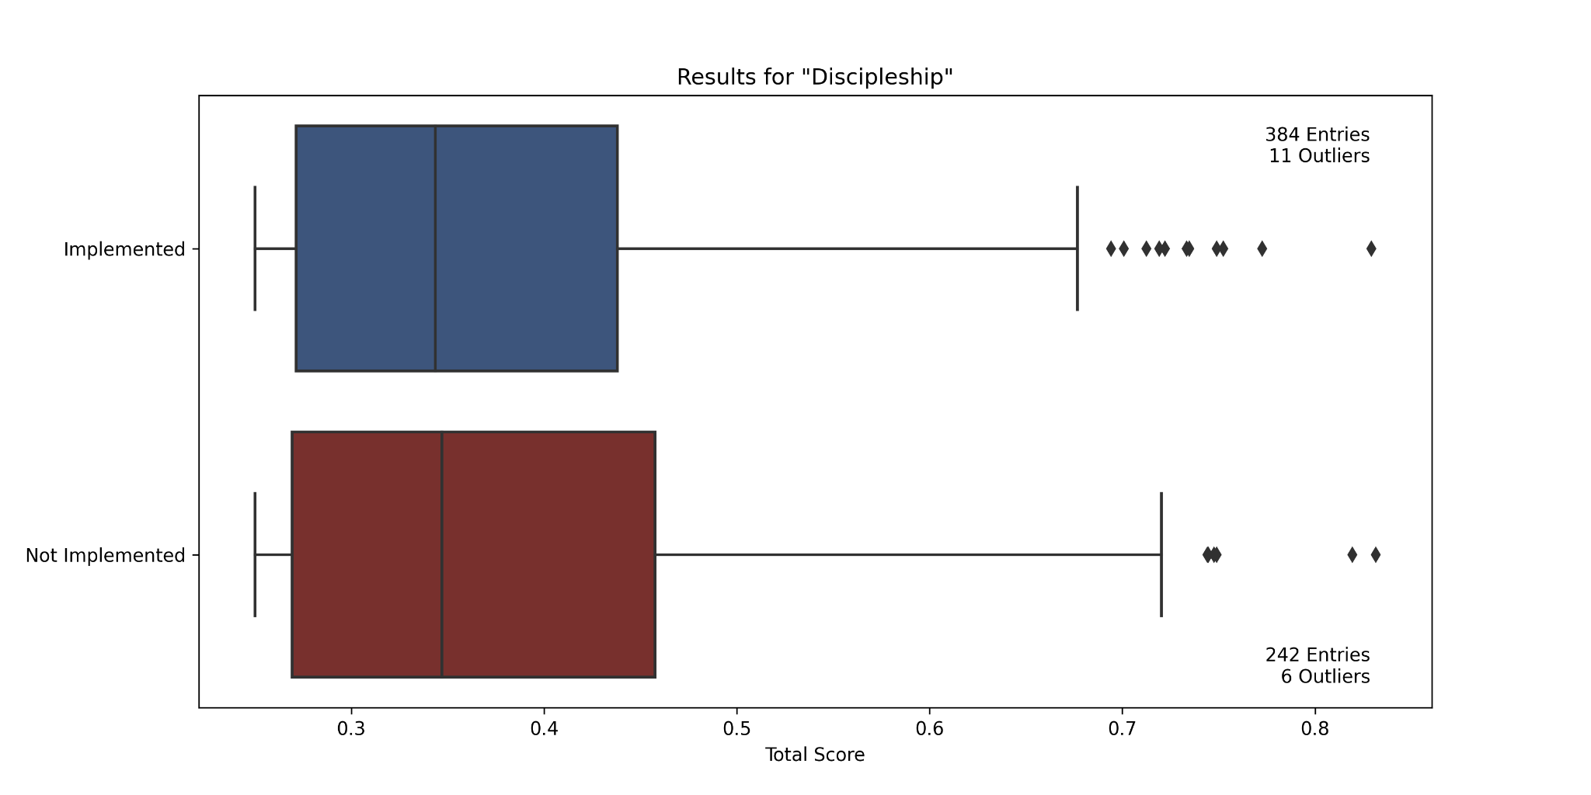
Discipleship
[Related Visualizations]
Permutation Importance
P-value: 0.0034
Reject H_{o}
Mean Implemented | Mean Not Implemented | Proportion Implemented in Q1 | Proportion Implemented in Q2 | Proportion Implemented in Q3 | Proportion Implemented in Q4
0.370 | 0.384 | 0.611 | 0.622 | 0.641 | 0.580
Notes:
All

Slide 26
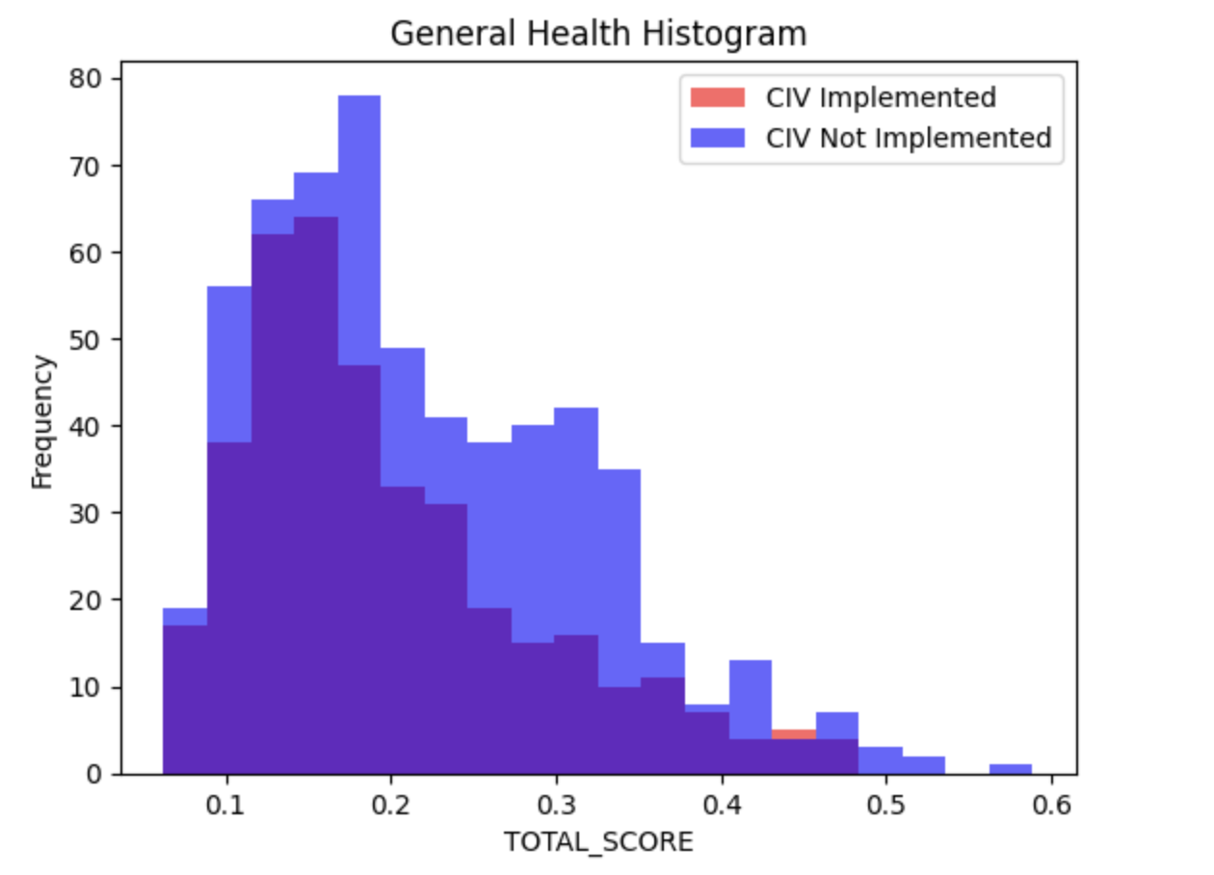
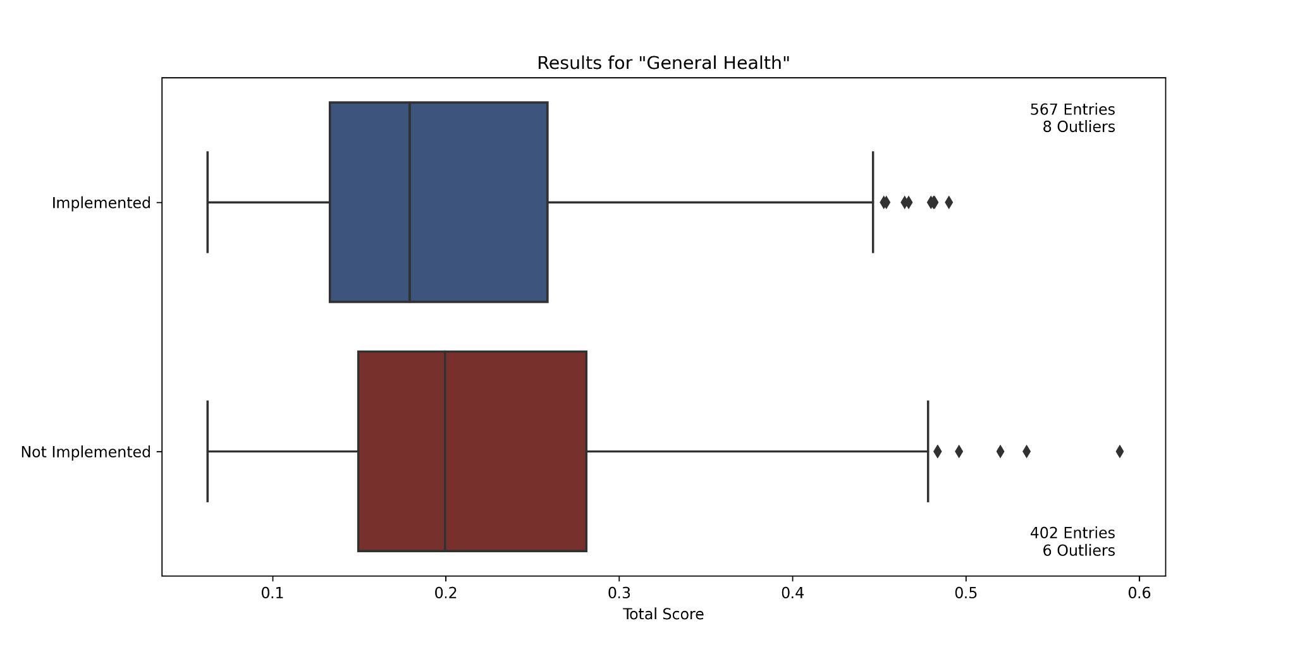
General Health
[Related Visualizations]
Permutation Importance
p-value: 0.0007
Reject H_{o}
Mean Implemented | Mean Not Implemented | Proportion Implemented in Q1 | Proportion Implemented in Q2 | Proportion Implemented in Q3 | Proportion Implemented in Q4
0.204 | 0.221 | 0.657 | 0.591 | 0.570 | 0.523
Notes:
All

Slide 27
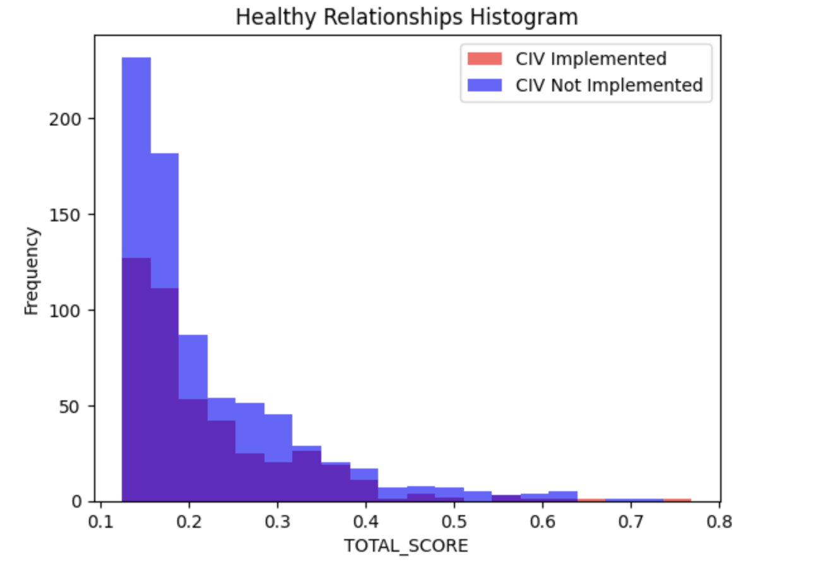
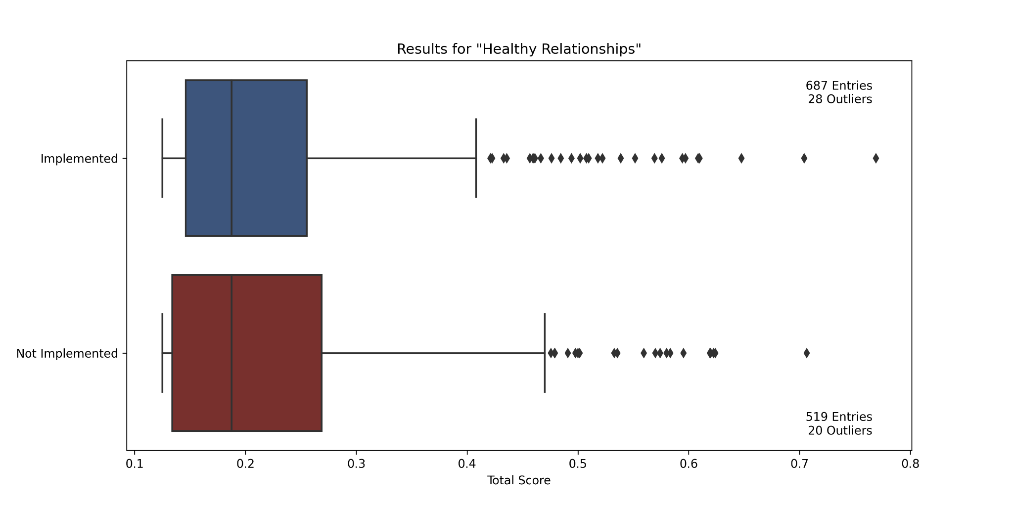
Healthy Relationships
[Related Visualizations]
Permutation Importance
P-value: 0.858
Fail to Reject H_{o}
Mean Implemented | Mean Not Implemented | Proportion Implemented in Q1 | Proportion Implemented in Q2 | Proportion Implemented in Q3 | Proportion Implemented in Q4
0.220 | 0.220 | 0.533 | 0.612 | 0.598 | 0.543
Notes:
All

Slide 28
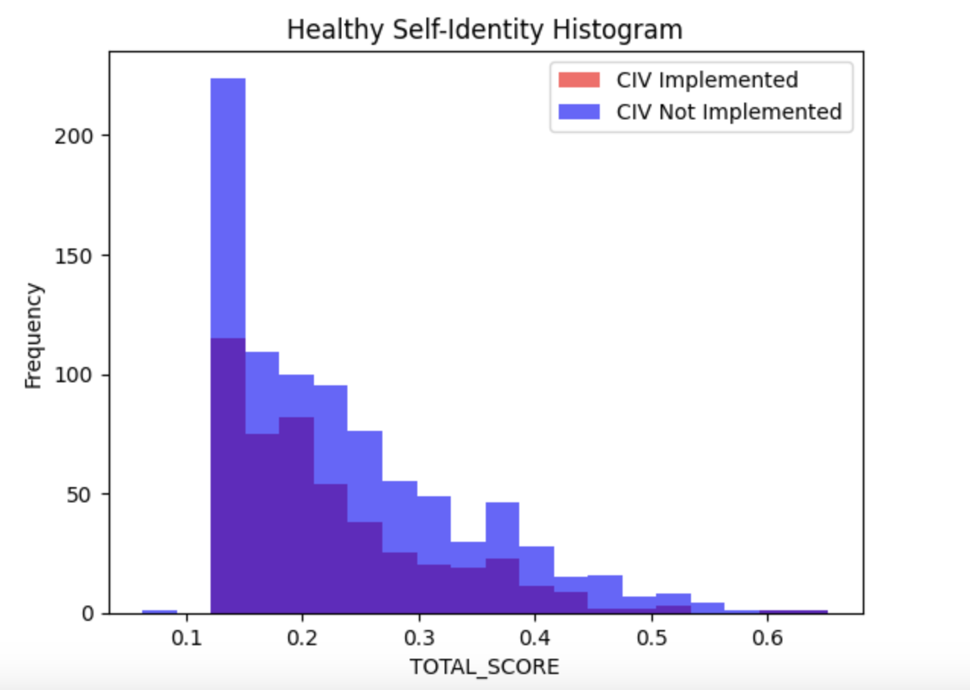
Healthy Self-Identity
[Related Visualizations]
Mean Implemented | Mean Not Implemented | Proportion Implemented in Q1 | Proportion Implemented in Q2 | Proportion Implemented in Q3 | Proportion Implemented in Q4
0.226 | 0.233 | 0.534 | 0.613 | 0.545 | 0.507
Permutation Importance
P-value: 0.0438
Reject H_{o}
Notes:
All

Slide 29
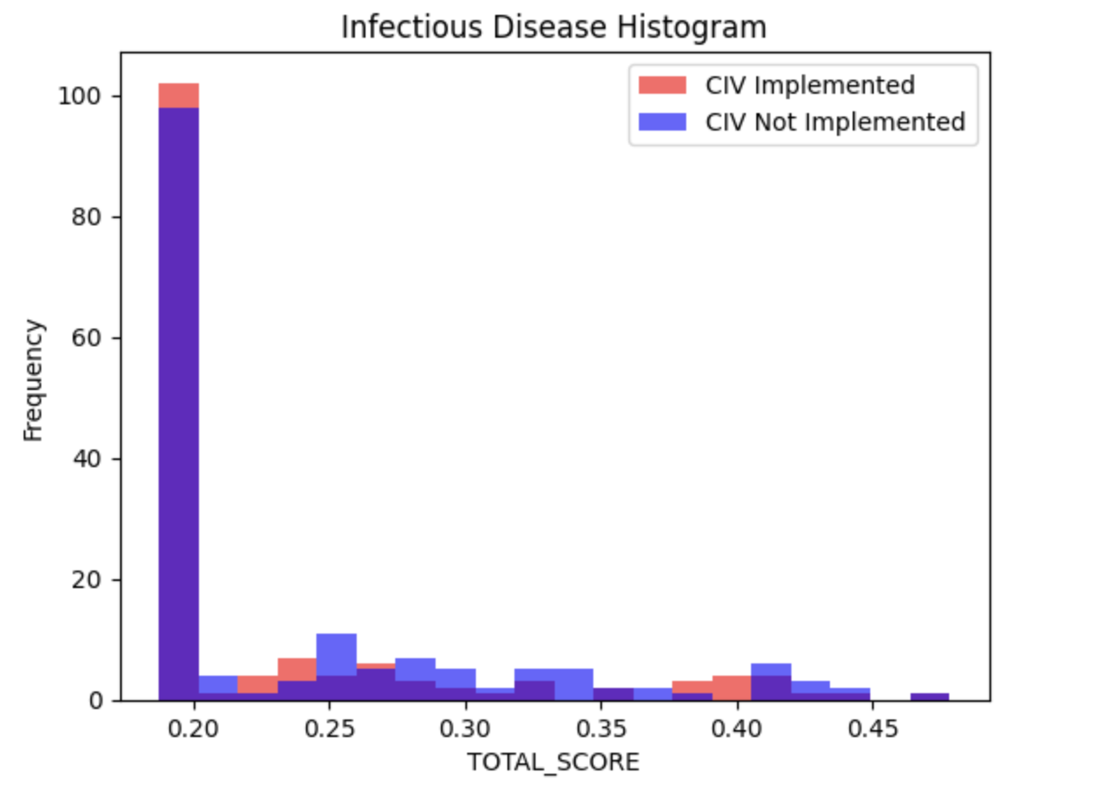
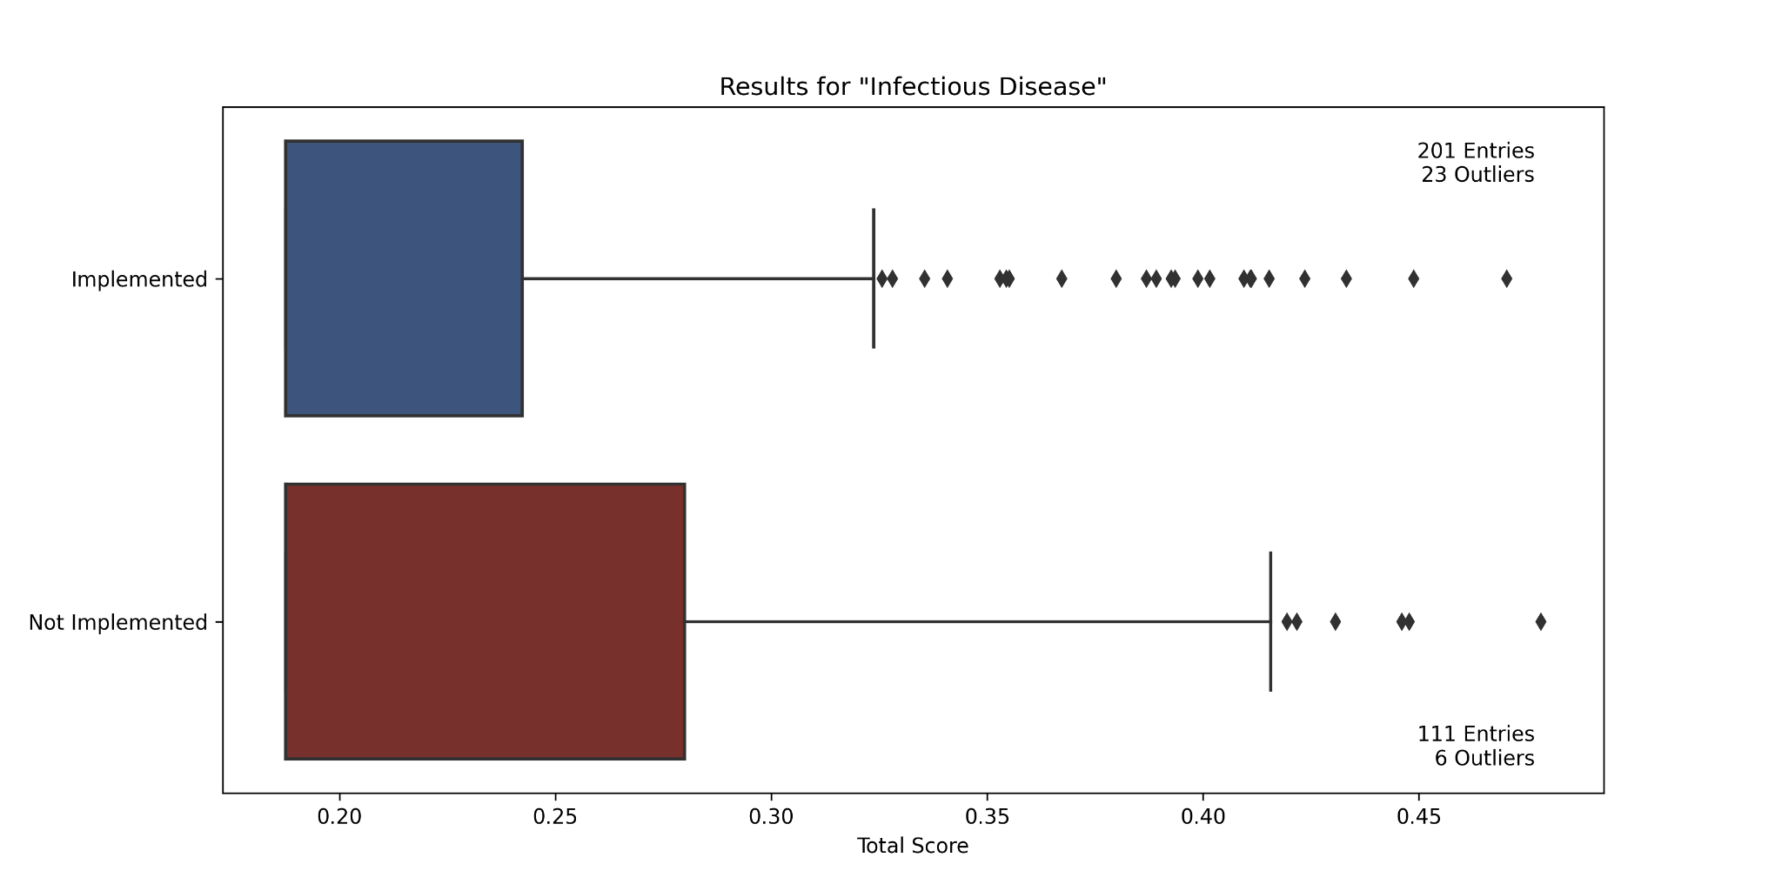
Infectious Disease
Permutation Importance
P-value: 0.159
Fail to Reject H_{o}
Mean Implemented | Mean Not Implemented | Proportion Implemented in Q1 | Proportion Implemented in Q2 | Proportion Implemented in Q3 | Proportion Implemented in Q4
0.225 | 0.244 | NA | NA | 0.679 | 0.538
Notes:
All

Slide 30
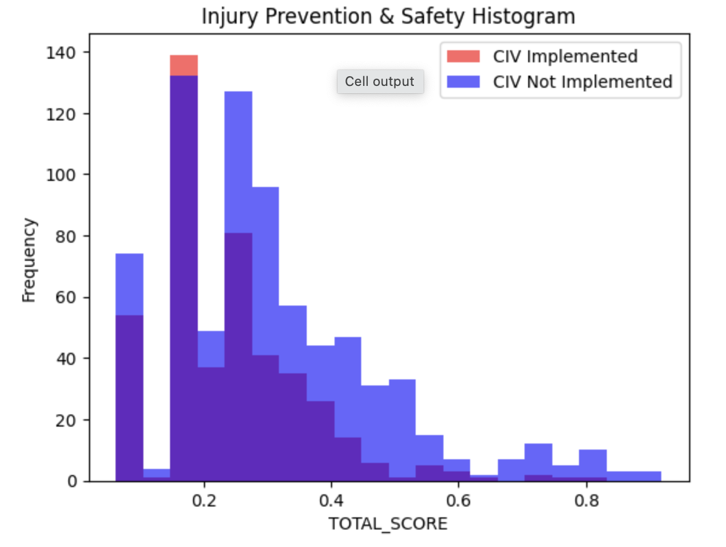
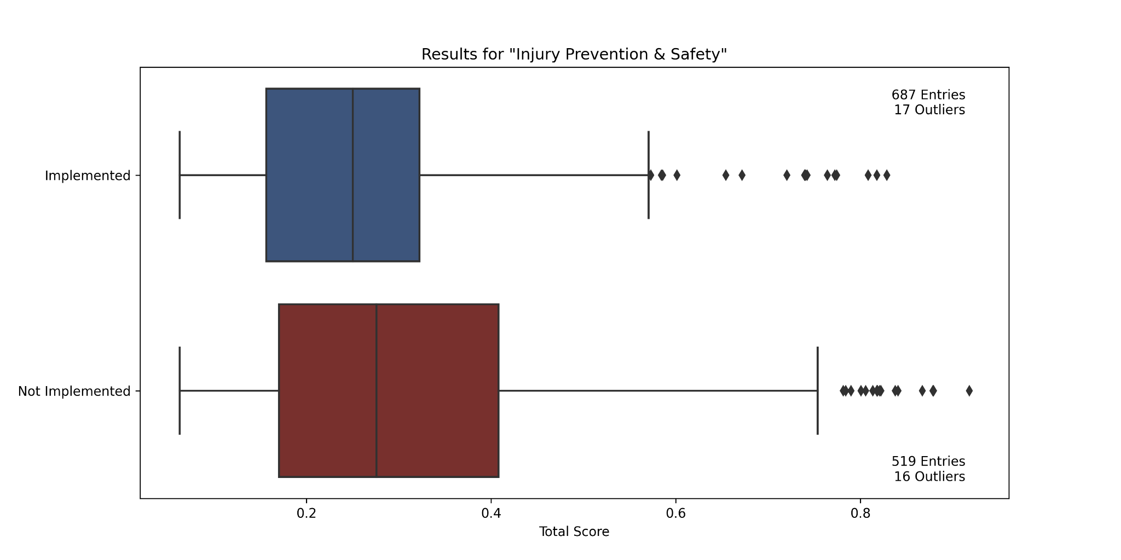
Injury Prevention & Safety
Permutation Importance
P-value: 0.000
Reject H_{o}
Mean Implemented | Mean Not Implemented | Proportion Implemented in Q1 | Proportion Implemented in Q2 | Proportion Implemented in Q3 | Proportion Implemented in Q4
0.254 | 0.310 | 0.562 | 0.657 | 0.581 | 0.450
Notes:
All

Slide 31
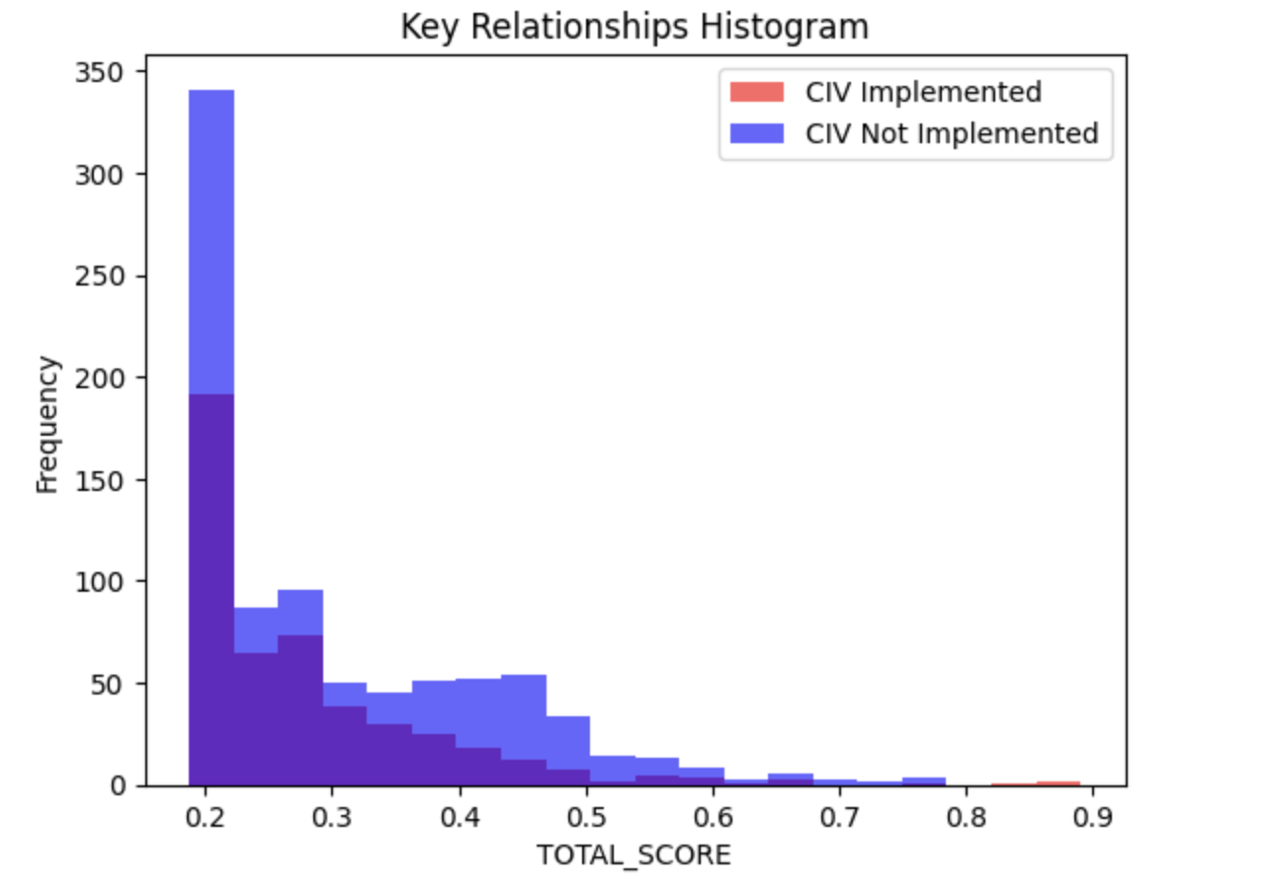
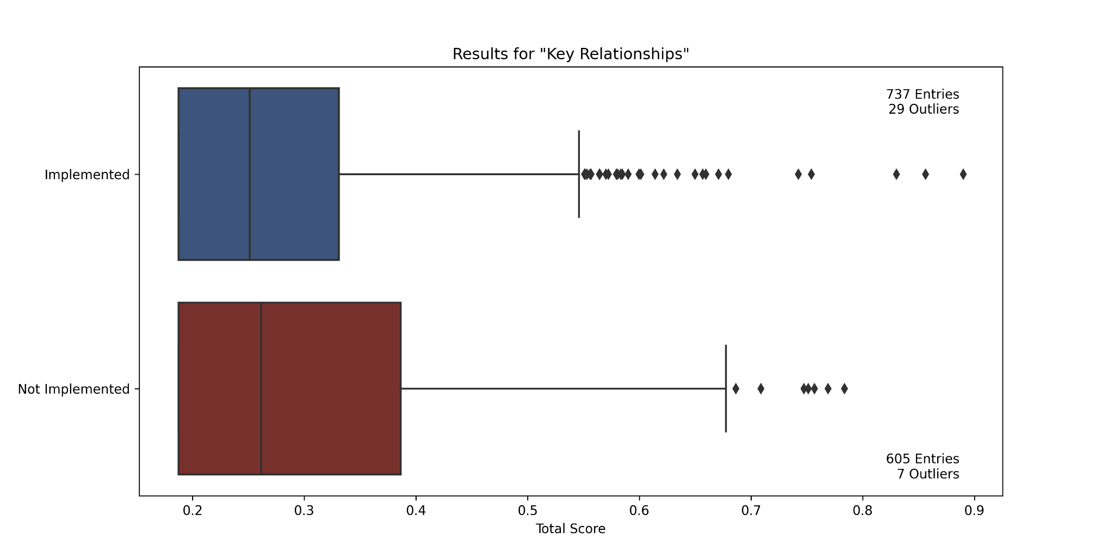
Key Relationships
Permutation Importance
p-value: 0.0016
Reject H_{o}
Mean Implemented | Mean Not Implemented | Proportion Implemented in Q1 | Proportion Implemented in Q2 | Proportion Implemented in Q3 | Proportion Implemented in Q4
0.283 | 0.300 | NA | 0.565 | 0.606 | 0.461
Notes:
All

Slide 32
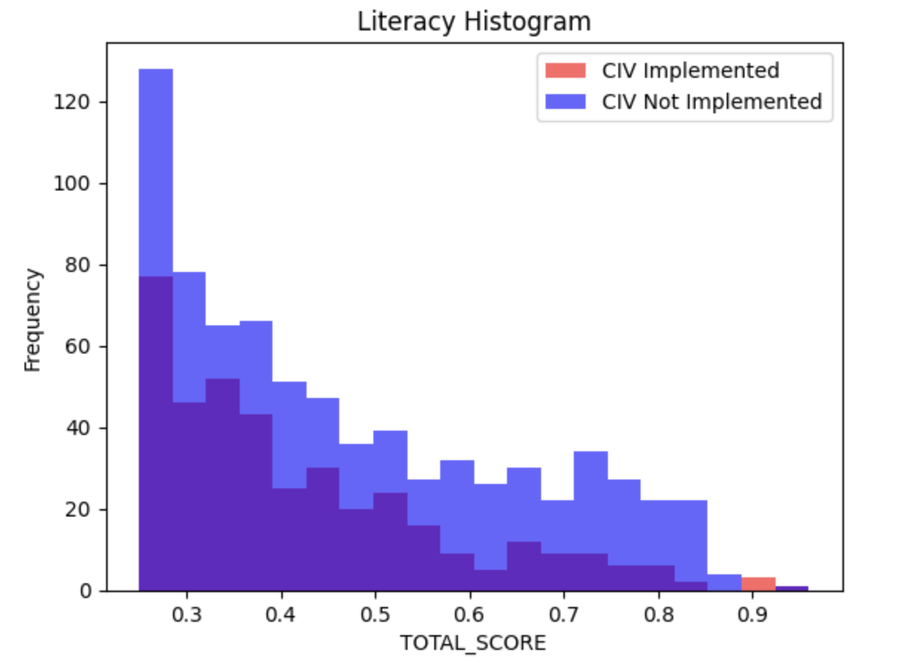
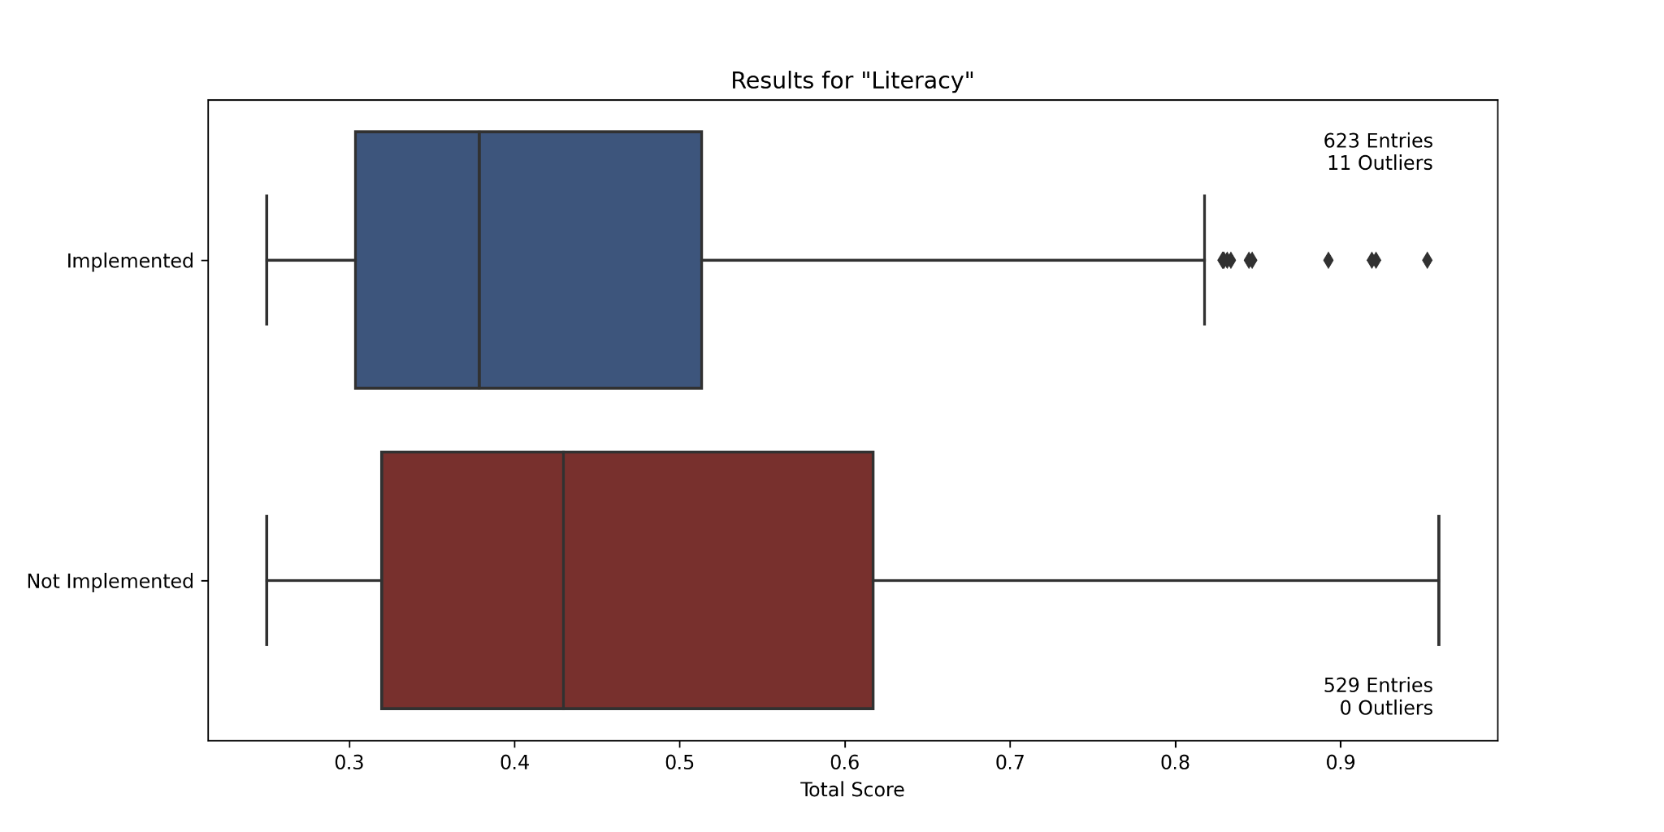
Literacy
[Related Visualizations]
Permutation Importance
p-value: 0.000
Reject H_{o}
Mean Implemented | Mean Not Implemented | Proportion Implemented in Q1 | Proportion Implemented in Q2 | Proportion Implemented in Q3 | Proportion Implemented in Q4
0.429 | 0.476 | 0.576 | 0.611 | 0.559 | 0.417
Notes:
All

Slide 33
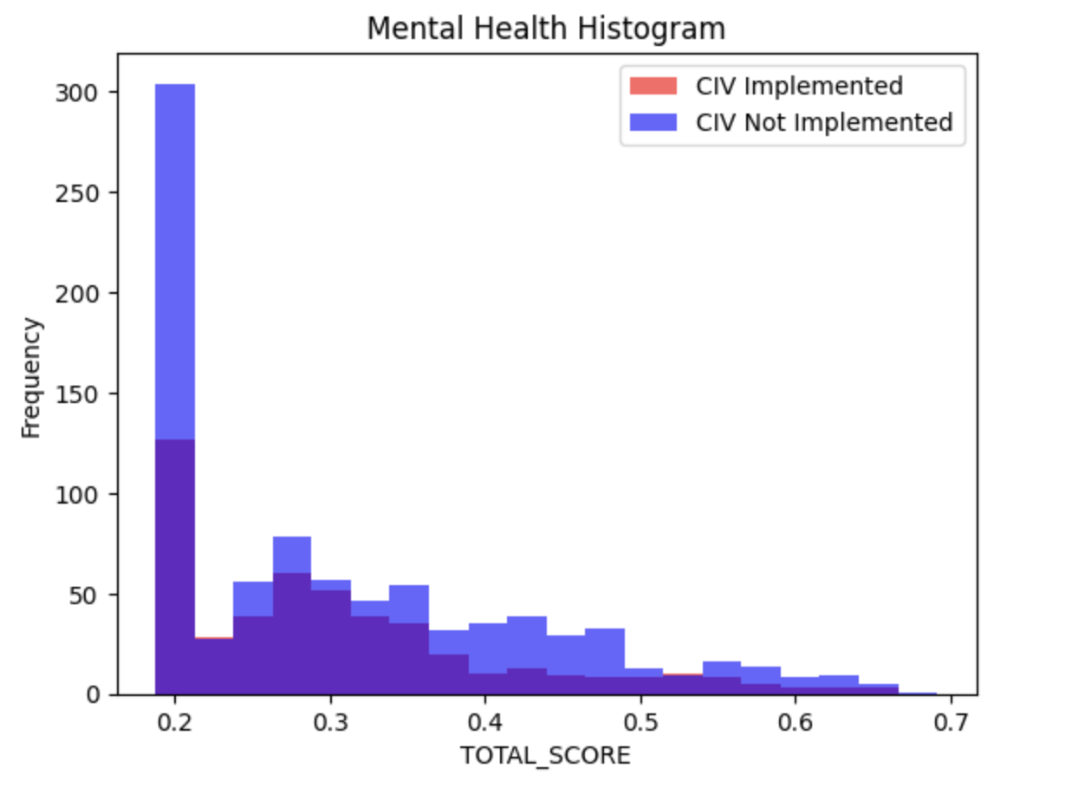
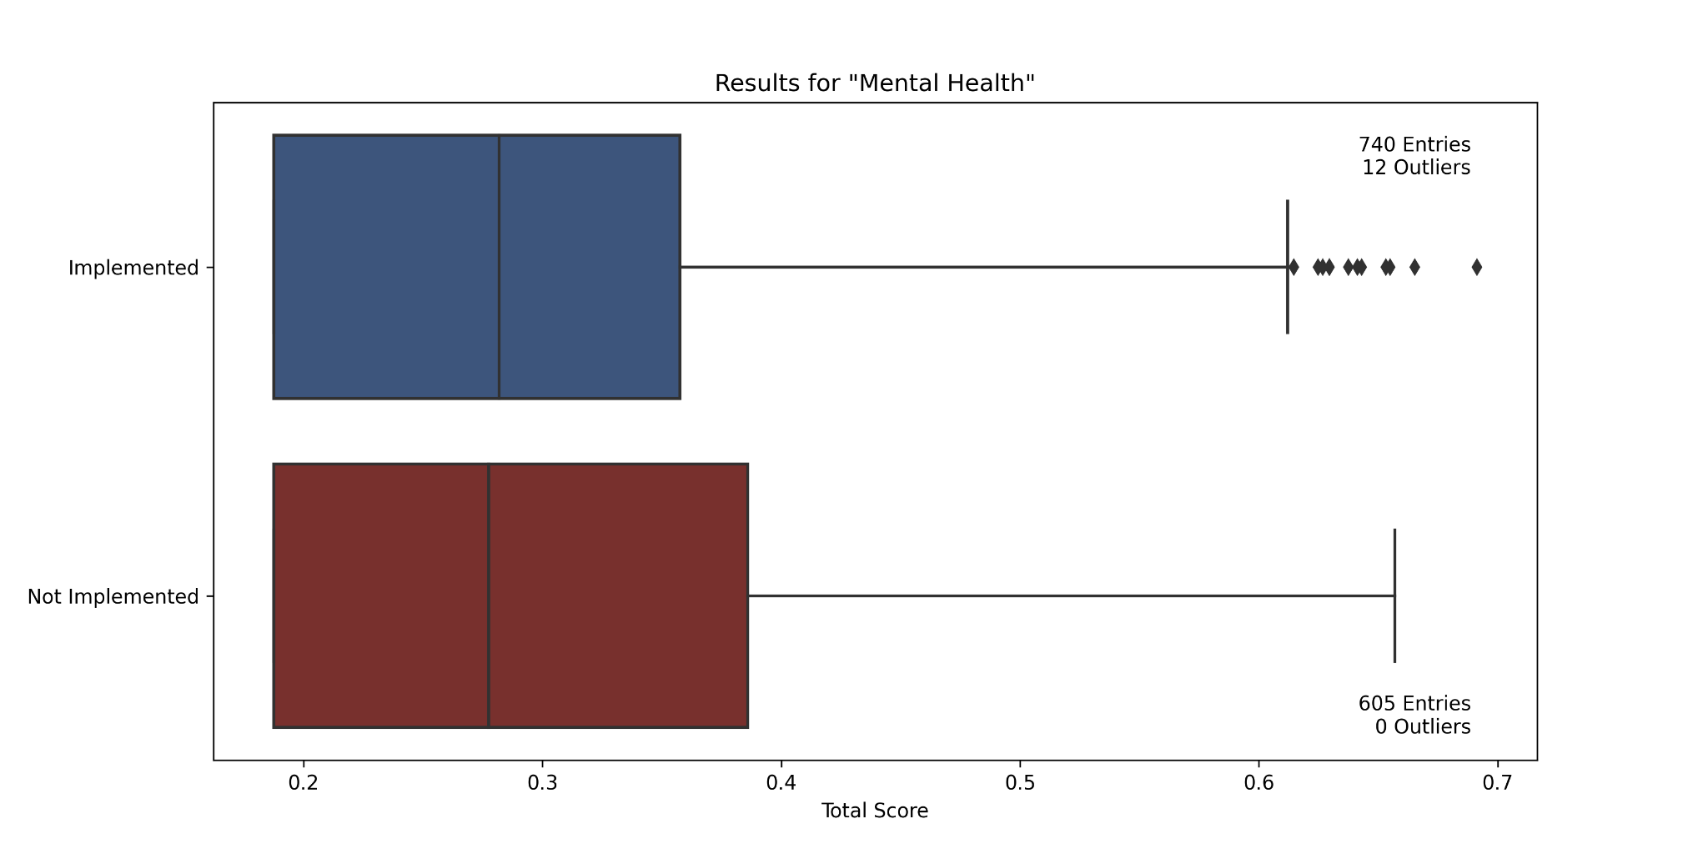
Mental Health
[Related Visualizations]
Permutation Importance
p-value: 0.4462
Fail to Reject H_{o}
Mean Implemented | Mean Not Implemented | Proportion Implemented in Q1 | Proportion Implemented in Q2 | Proportion Implemented in Q3 | Proportion Implemented in Q4
0.303 | 0.305 | NA | 0.542 | 0.619 | 0.499
Notes:
All

Slide 34
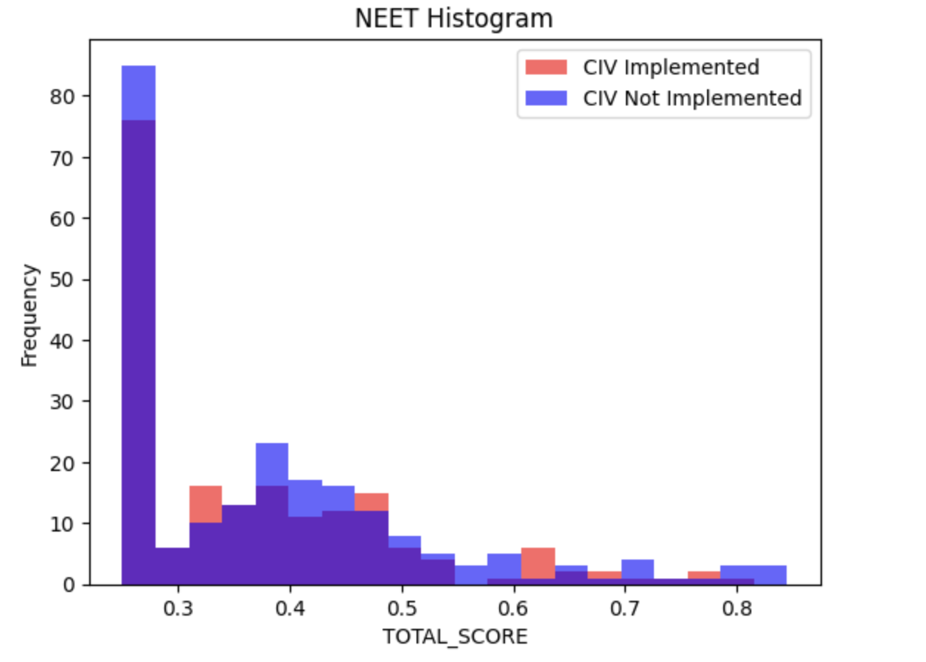
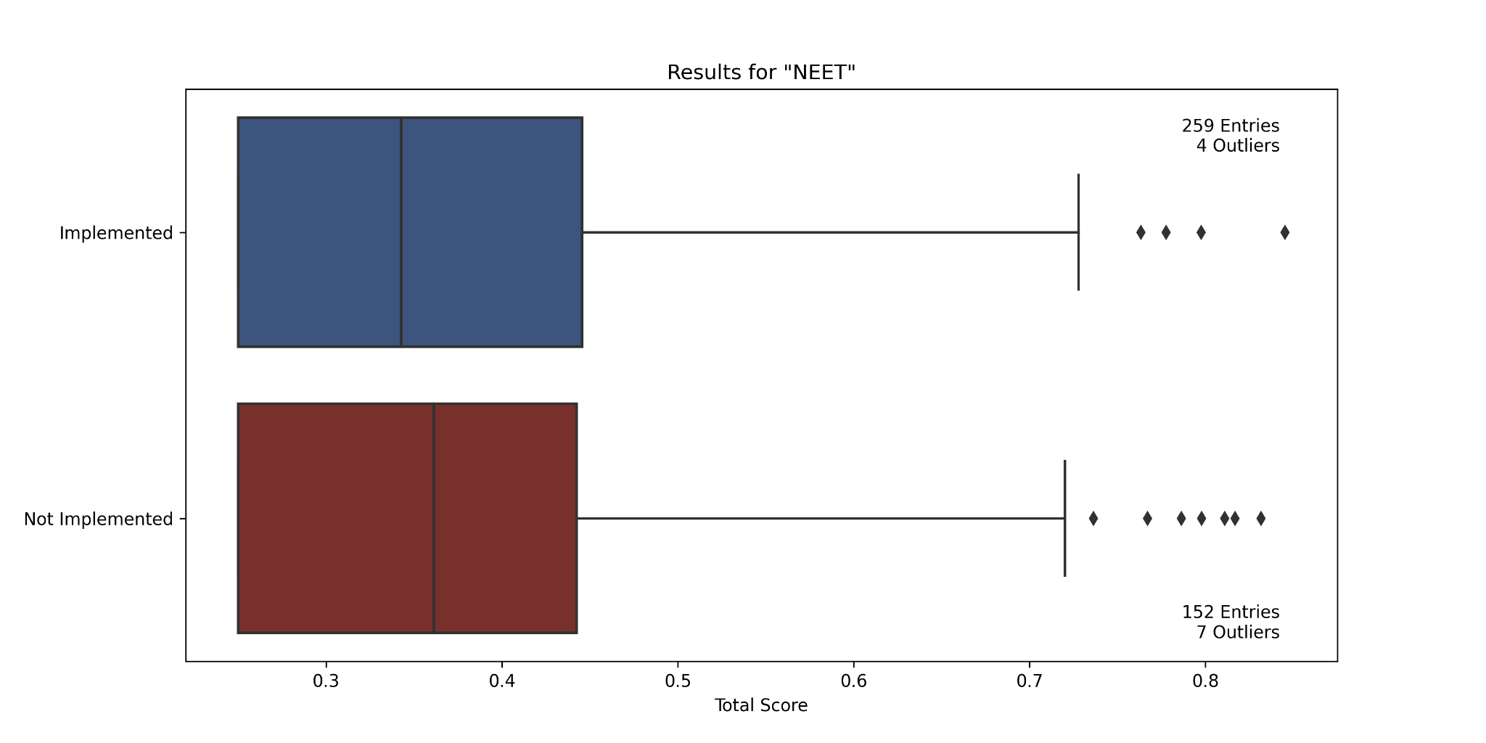
NEET
[Related Visualizations]
Permutation Importance
p-value: 0.295
Fail to Reject H_{o}
Mean Implemented | Mean Not Implemented | Proportion Implemented in Q1 | Proportion Implemented in Q2 | Proportion Implemented in Q3 | Proportion Implemented in Q4
0.367 | 0.379 | NA | 0.649 | 0.583 | 0.641
Notes:
All

Slide 35
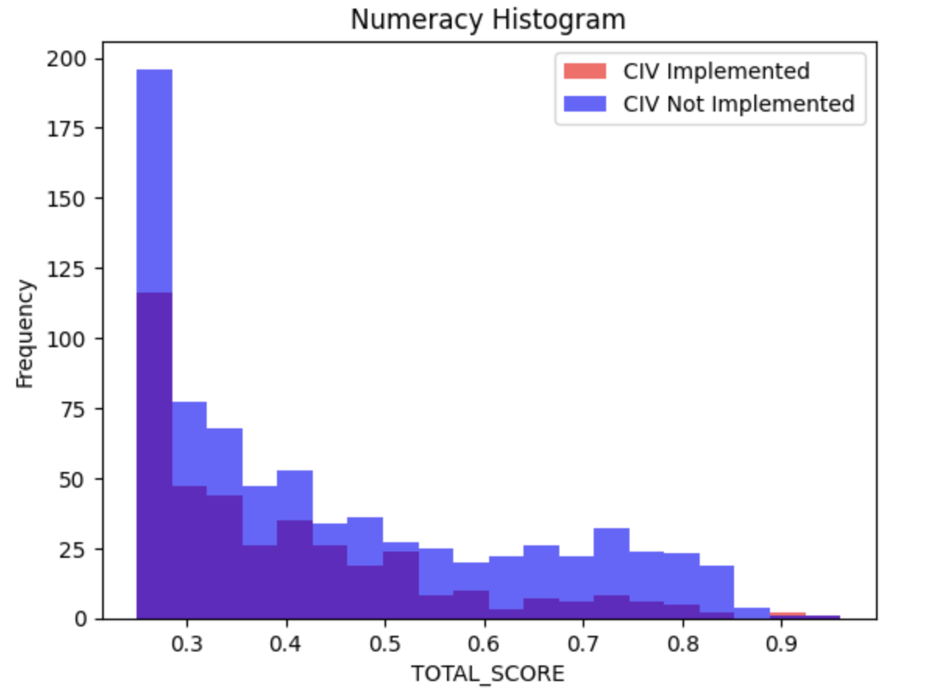
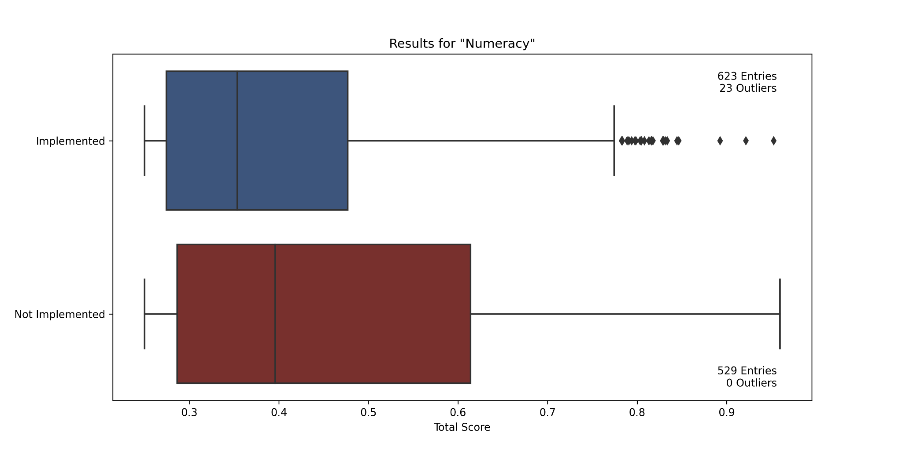
Numeracy
Permutation Importance
P-value: 0.00
Reject H_{o}
Mean Implemented | Mean Not Implemented | Proportion Implemented in Q1 | Proportion Implemented in Q2 | Proportion Implemented in Q3 | Proportion Implemented in Q4
0.402 | 0.455 | 0.587 | 0.573 | 0.622 | 0.382
Notes:
All

Slide 36
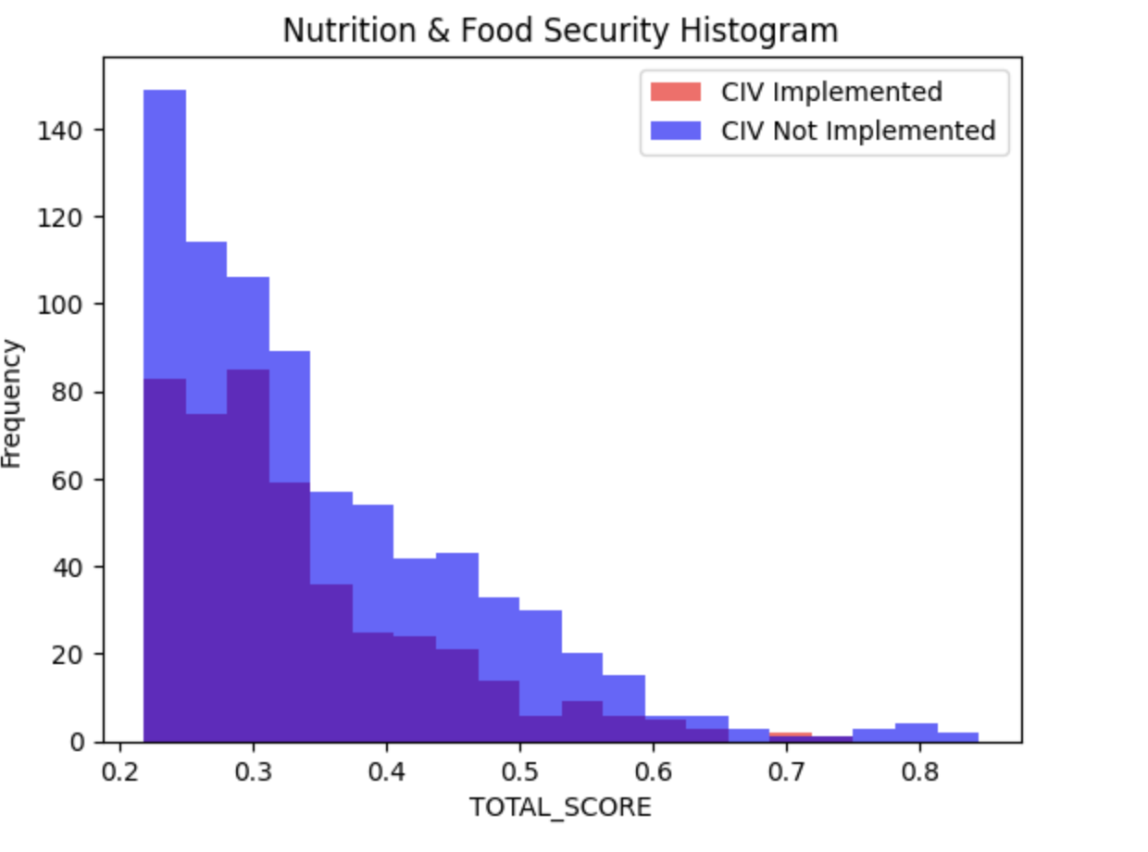
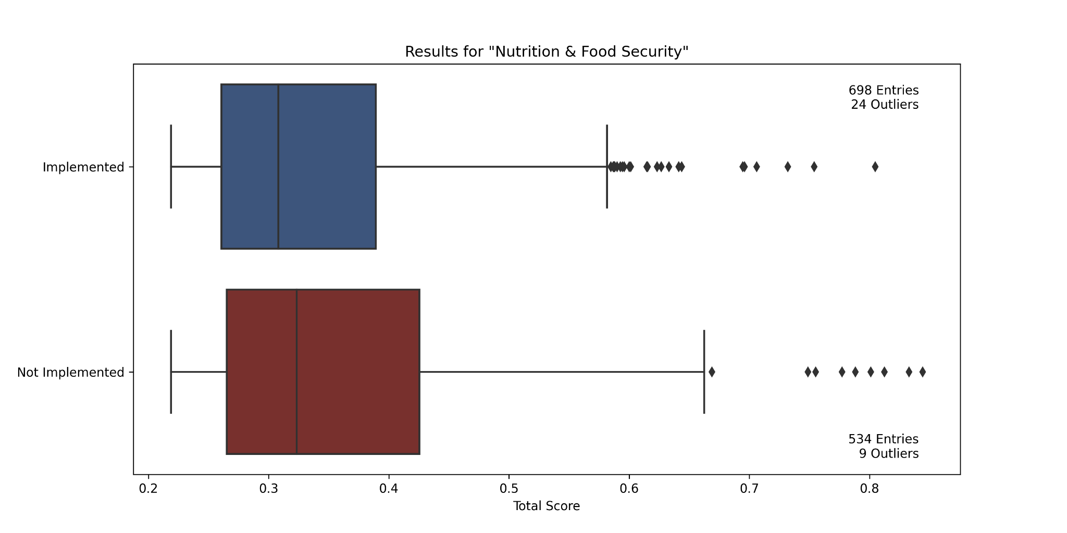
Nutrition & Food Security
[Related Visualizations]
Permutation Importance
P-value: 0.0032
Reject H_{o}
Mean Implemented | Mean Not Implemented | Proportion Implemented in Q1 | Proportion Implemented in Q2 | Proportion Implemented in Q3 | Proportion Implemented in Q4
0.339 | 0.358 | 0.581 | 0.627 | 0.565 | 0.494
Notes:
All

Slide 37
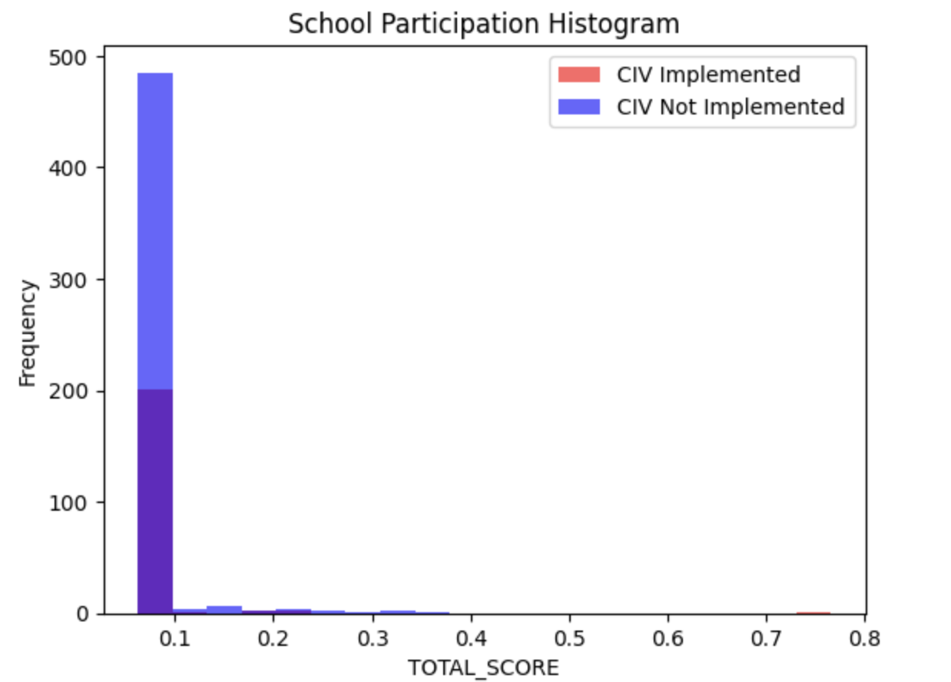

School Participation
[Related Visualizations]
Permutation Importance
P-value: 0.9955
Fail to Reject H_{o}
Mean Implemented | Mean Not Implemented | Proportion Implemented in Q1 | Proportion Implemented in Q2 | Proportion Implemented in Q3 | Proportion Implemented in Q4
0.069 | 0.069 | NA | NA | NA | 0.493
Notes:
All

Slide 38


Sexual and Reproductive Health
[Related Visualizations]
Permutation Importance
P-value: 0.1989
Fail to Reject H_{o}
Mean Implemented | Mean Not Implemented | Proportion Implemented in Q1 | Proportion Implemented in Q2 | Proportion Implemented in Q3 | Proportion Implemented in Q4
0.285 | 0.298 | 0.667 | 0.756 | 0.526 | 0.628
Notes:
All

Slide 39


Spirituality
[Related Visualizations]
Permutation Importance
P-value: 0.0016
Reject H_{o}
Mean Implemented | Mean Not Implemented | Proportion Implemented in Q1 | Proportion Implemented in Q2 | Proportion Implemented in Q3 | Proportion Implemented in Q4
0.331 | 0.349 | NA | 0.566 | 0.603 | 0.461
Notes:
All

Slide 40


Vision for Change and Contribution
[Related Visualizations]
Permutation Importance
P-value: 0.0035
Reject H_{o}
Mean Implemented | Mean Not Implemented | Proportion Implemented in Q1 | Proportion Implemented in Q2 | Proportion Implemented in Q3 | Proportion Implemented in Q4
0.286 | 0.298 | 0.627 | 0.643 | 0.643 | 0.544
Notes:
All

Slide 41


WASH
[Related Visualizations]
Permutation Importance
P-value: 0.000
Reject H_{o}
Mean Implemented | Mean Not Implemented | Proportion Implemented in Q1 | Proportion Implemented in Q2 | Proportion Implemented in Q3 | Proportion Implemented in Q4
0.308 | 0.343 | 0.656 | 0.592 | 0.534 | 0.418
Notes:
All

Slide 42

Model
Used XGBoost to create a model that predicts the results score for a given FCP
Inputs:
EST Cost Per Beneficiary
EST Number of Impacted Beneficiaries
*Funding Status
*FCP ID
*Proposed Start Date
*Category
*Subcategory
Total Intervention Amount
Output: Total Score
* encoded as numbers
Notes:
Eileen

Slide 43
Model Results
Mean Absolute Error: 0.09526021677454913
Sample predictions:
Sample true data:
Notes:
Eileen

Slide 44
Takeaways + Next Steps
Notes:
Mohan

Slide 45


Mean Results Score Summary
Notes:
Lauren

Slide 46


Issues with Results Score
Strange distributions of result scores in L2 data
In all but 3 need categories, over 8% of result scores in the category were identical
Among the remaining 3, 4%, 4%, and 1% of result scores were the same value
In School Participation, 95% of result scores were identical
Most common modes were “nice” numbers: 3/16, 1/16, ¼
In some cases, concentrated by age group
Unsure of cause and implications. Would need to understand how results score was measured.
Notes:
Lauren

Slide 47
Permutation Importance Summary
At a significance score of 0.1 we were able to reject the null hypothesis for 72% of our data
We can be relatively confident that there is some sort of rationale behind which projects get CIVs implemented
Upon further examination of those we could not reject, it is still possible that there is some sort of scheme that goes deeper than total score in deciding whether to implement CIVs or not
Notes:
Shea

Slide 48
Box and Whisker Plots and Bar Charts Summary
Overlaid histograms and boxplots help show that the total scores across all categories are higher when CIVs haven’t been implemented compared to when they have been implemented.
Evidenced by near-complete overlap of red bars by blue bars for all visualizations
Also highlight a particularity of the data for “School Participation” and other categories: a mode of 3/16 (0.1875) dominates the result-scores and appears overrepresented
The difference of the averages between no CIV implemented and CIV implemented was never very large.
WASH, Numeracy, and Literacy showed the most significant mean differences.
Notes:
Joseph, Dries

Slide 49
Next Steps
Data Improvements:
Temporal data would greatly improve the ability to determine impact of CIVs
Control data to compare like-locations locations: rural vs urban, average income, average age, sex
Would improve model performance and ensure we are making fair comparisons
Understand how L2 data was collected (potentially re-run analysis)
Explore alternatives to comparing L2 scores
Currently we pursue a mean based approach, but could try using Wilcox rank test or ANOVA test
Improving our model
Currently we are using an XGBoost model, which we can improve with additional data inputs like FCP ID, descriptions, category names
We can also do some more hyperparameter tuning, particularly using something like grid search instead of manually seeing how changing these hyperparameters effects model performance
Can employ Neural Networks instead of XGBoost
Notes:
Ozzy

Slide 50
Thank You! + Further Links
Complete visualizations stratified by need category and age group (link)
Deepnote code (link)
Final presentation zoom recording (link)
Notes:
Mohan and Ozzy

